Slide 1
NORTH FLORIDA OLIVE FIELD DAY
Dana Venrick
DeLand, Volusia County – Olive & Fruit Tree Nursery
Winter Haven, Polk County – Olive Grove
Founder & President, Quality Green Specialists, Inc., DeLand, FL 32720
Olive & Fruit Tree Consulting Services
Comprehensive Soil, Water & Plant Tissue Testing
Contact: danavenrick@yahoo.com Cell: 386-837-3878

Slide 2
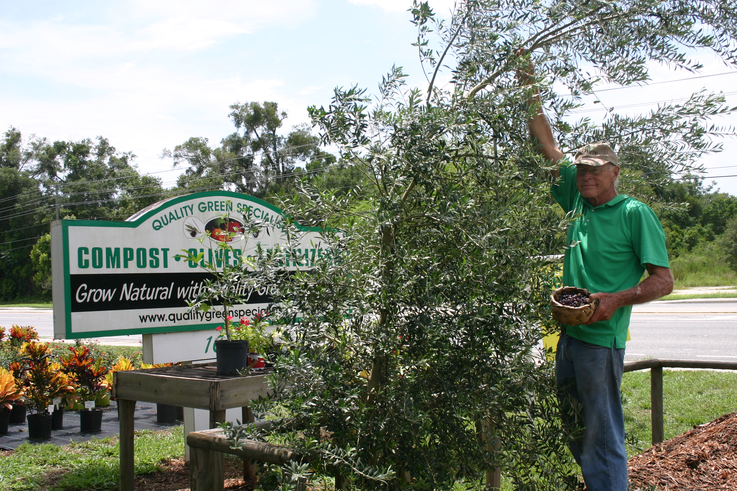
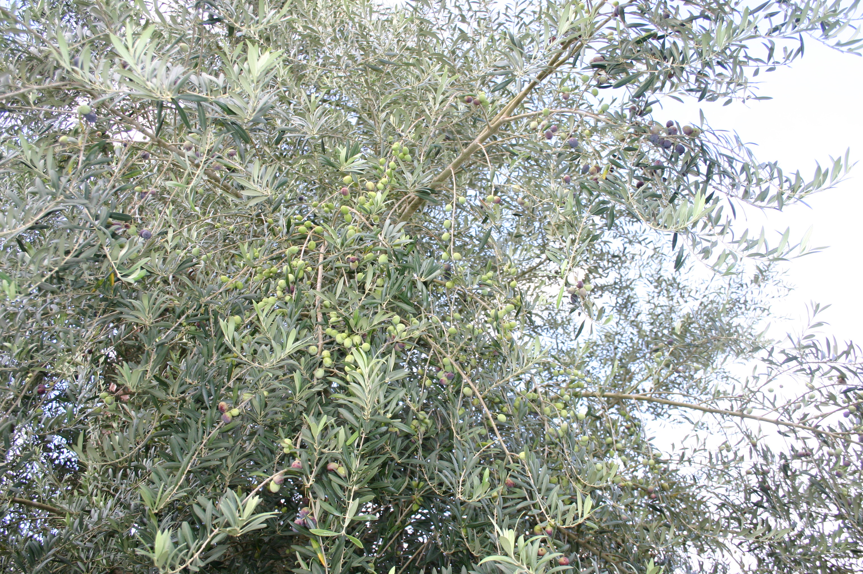
Starting the Olive Grove in Polk County
Venrick Olives - Louella Venrick & Dana Venrick
√ Became interested in Olives while working as Commercial Extension Agent –
circa 2001 when told that olives were being grown in Marion County.
√ Started growing olive trees from liners upon retirement in 2010 – DeLand Nursery.
√ First four test trees planted in 2013 in Winter Haven.
√ Some olives on first four test trees in 2015.
√ Over 100 more Arbequina (& Koroneki & Chemlali Pollinators) planted in 2016.
√ Heavy load of olives on first 4 test trees in 2018.

Slide 3
Setting Up the Olive Grove:
● Arbequina selected for the primary variety because it is proven to produce good quality olives and oil in warmer climates and it is self-fertile.
● Koroneki and Chemlali selected for pollinators because of high quality, hardiness, and known to bloom & fruit in warmer climates.
● Soil tested to determine amount of alkaline minerals to add to acidic soil
(goal is to raise pH above 6.5).
● Soil prepared with dolomitic limestone and volcanic pumice (20 pounds of each per 1,000 square feet for the entire block of trees to raise pH and to mineralize the soil.
● No irrigation planned or installed. Young trees to be watered frequently to start with trailed water tank with gas motor and hose. Established trees are watered when dry.
● Gallon-size plants planted 10’ apart in rows with 16’ centers.
● Grove mowed as needed and hoed around trees to keep bare soil.

Slide 4
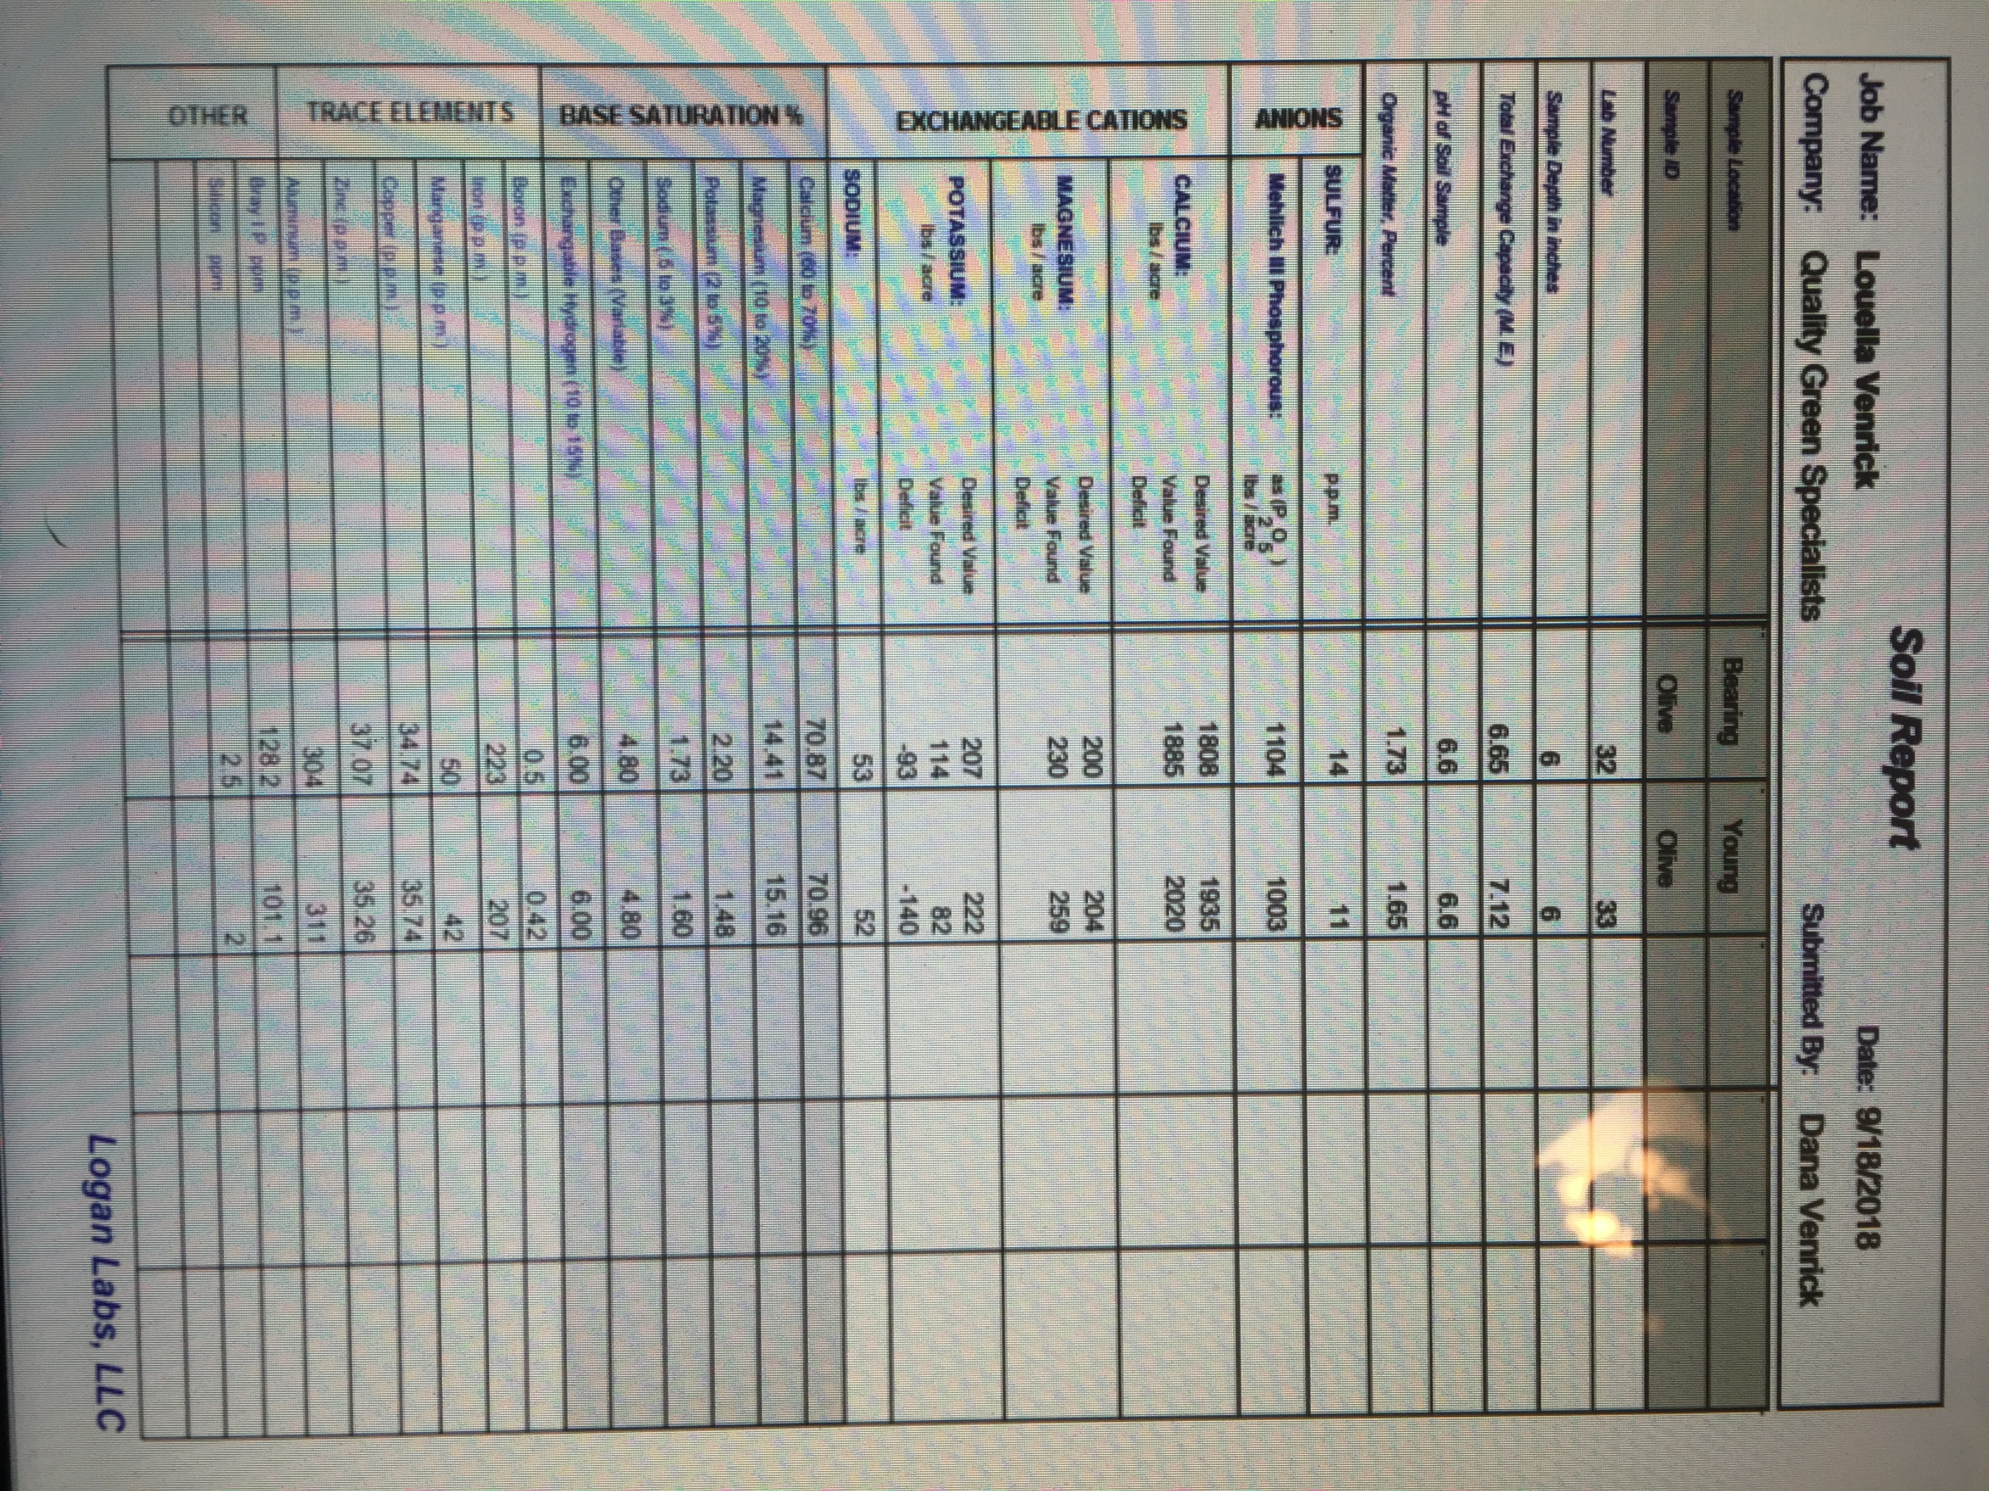
Bearing Trees: pH 6.6
Young, non-bearing trees: pH 6.6
Ca:Mg Ratio - Bearing Trees: 8.2:1
Ca:Mg Ratio - young non-bearing: 7.8:1
Mg: K Ratio - Bearing Trees: 2:1
Mg:K Ratio - young non-bearing: 3.2:1
Bearing trees low in K by 93 lbs/acre
Non-bearing deficient by 140 lbs/acre
Micros: Non-bearing trees lower in
boron, iron, and manganese

Slide 5
Planting & Maintaining
● Trees planted 12’apart with 16’ middles.
● No organic matter or mulch used – only dolomite & Azomite to start.
● Trees watered every 2nd day for two weeks, then watered as drying out.
● Grove mowed both directions – we hoe a circular area around trees.
(no glyposate or herbicides!)
● Trees trimmed as they grow – sides & top in spring (non-bearing & trees with light fruit load). Trees that had a heavy fruit load in 2018 were pruned hard this spring (2019) – we expect lots of fruit in 2020 from the new growth in 2019 (only a few fruit this year).
● Trees sprayed with copper glucoheptonate as soon as they are pruned.
● Fruit hand-picked as soon as they are turning from green to black – if not picked early, ants & birds start to enjoy the olives – plus picking early minimizes alternate bearing.

Slide 6
Fertilizing:
● We apply the first fertilizer application of the year before bud break in January. 75% of the total nitrogen requirement is applied at this time. 25% of the total nitrogen is applied in April or May (after fruit set).
● 20-30 pounds of Nitrogen (N) per acre of root zone per year! None after July at the latest!
● 40 pounds of Phosphorus (P) only when needed (Base on soil testing)
● 80 pounds of Potassium (K) using Potassium Magnesium Sulfate (SPM) and/or potassium sulfate (SOP) or Kieserite to make the magnesium to potassium ratio 1:1 or a little higher.
● We test soil & take leaf tissue samples in late June or July – then after harvest when fruit production begins to determine January inputs.
● Trees are given micronutrients as needed – organic micros work best for us.
We use very little potassium chloride /KCL, a.k.a Muriate of Potash) – 100 ppm chloride in the soil is optimum - > 0.50% Chloride is toxic!
We use primarily organic-based fertilizer ingredients with low salt index –
> 0.20% sodium in the soil is toxic!

Slide 7
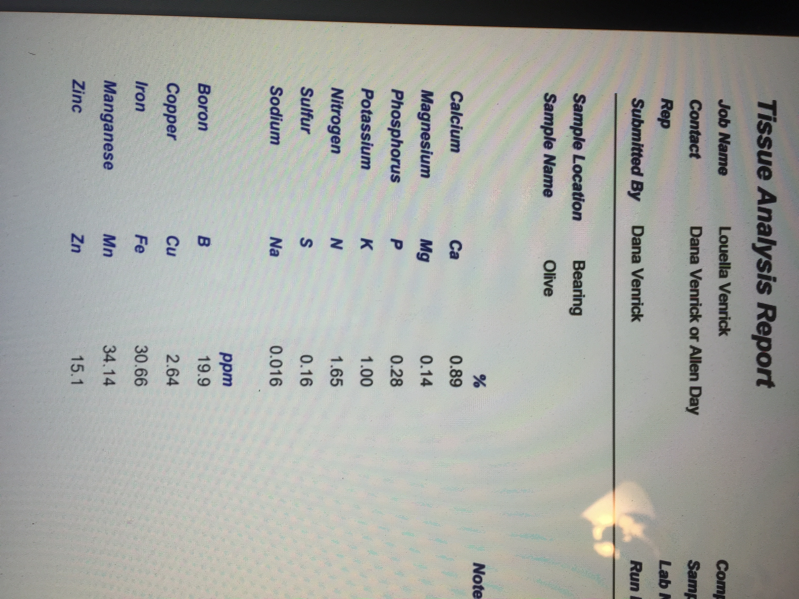

Slide 8
Tissue results after heavy bearing compared to researched standards:
VENRICK RESULTS: RESEARCHED STANDARDS:
9-14-18 Test Results Deficient Optimum Toxic Status
Calcium 0.89%..........<0.6%.........1.0 - 1.43%.....>3.15%.........Low
Magnesium 0.14%.........<0.08%........0.1 - 0.16%.....>0.69%........Optimum
Phosphorus 0.28%.........<0.05%.........0.1 – 0.3%......>0.34%........Optimum
Potassium 1.00%..........<0.4%..........0.8 – 1.0%......>1.65%........Optimum
Nitrogen 1.65%..........<1.4%..........1.5 – 2.0%.......>2.55%.......Optimum
Sulfur 0.16%..........<0.02%........0.08 – 0.16%.....>0.32%.......Optimum
Sodium 0.016%...............................................>0.2%.........Not toxic
Boron 19.9 ppm………<14 ppm……..19-150 ppm……..>185 ppm….Optimum
Copper 2.64 ppm…….<1.5 ppm……….4 – 9 ppm………..>78 ppm…...Low
Iron 30.66 ppm……<40 ppm……….90-124 ppm……..>460 ppm…..Deficient
Manganese 34.14 ppm…….<5 ppm………...20-36 ppm………>164 ppm…..Optimum
Zinc 15.1 ppm……..<8 ppm………….10-24 ppm………..>84 ppm…..Optimum

Slide 9
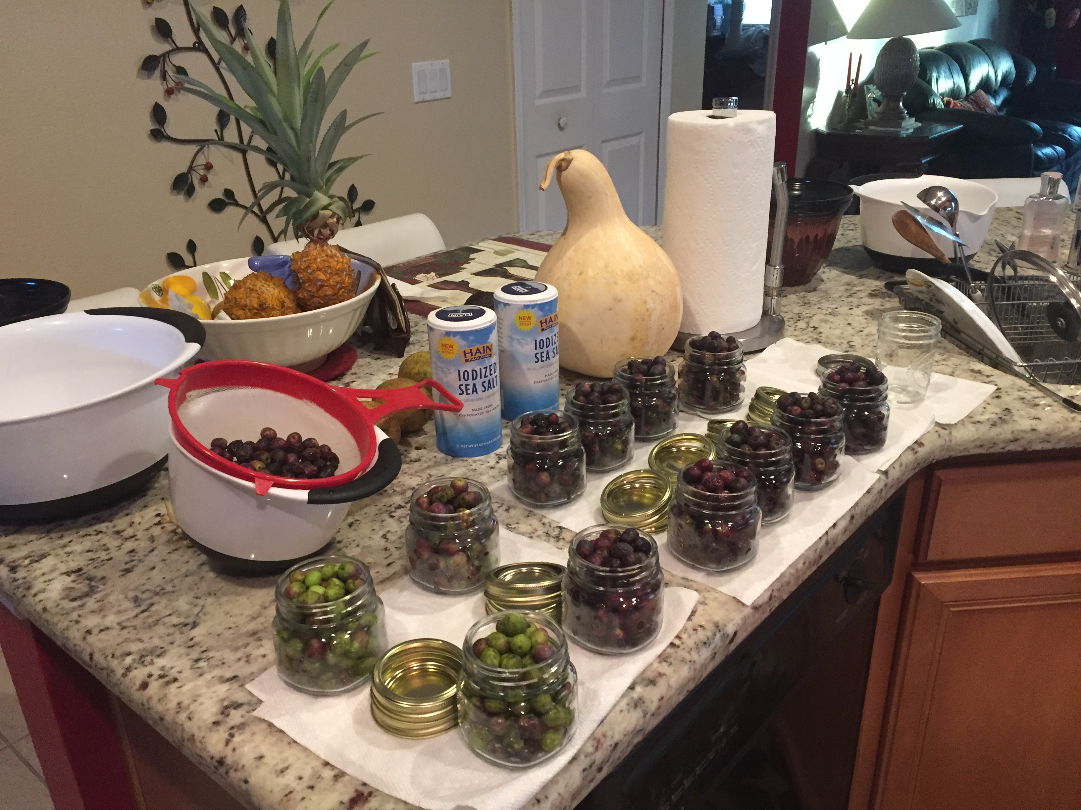
Canning Olives

Slide 10
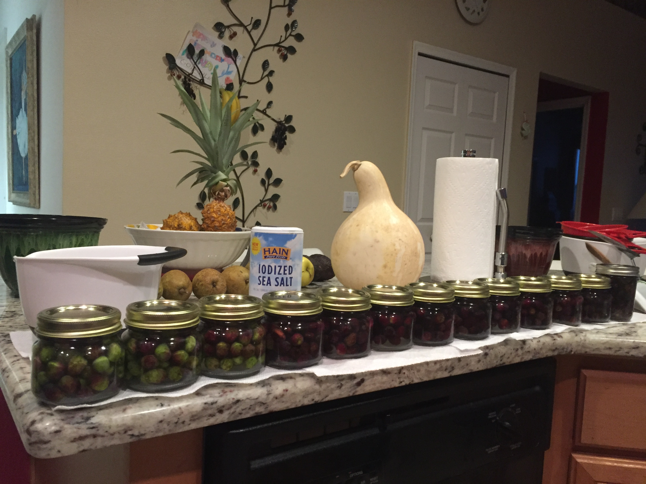

Slide 11
The Olive Specialists Dana Venrick, President danavenrick@yahoo.com Allen Day, Vice President daylite2@yahoo.com Quality Green Specialists, Inc 1639 N. Spring Garden Ave. (S.R. 15A), DeLand, FL 32720 http://www.qualitygreenspecialists.com Open 8 a.m. – 5:00 p.m. Mon. – Sat. Comprehensive Consulting Services, soil & plant tissue testing, water testing, fruiting plants – reasonably priced. 386-837-3878 (Dana) 386-747-0567 (Allen) 386-734-8000 (Store)

