Slide 1
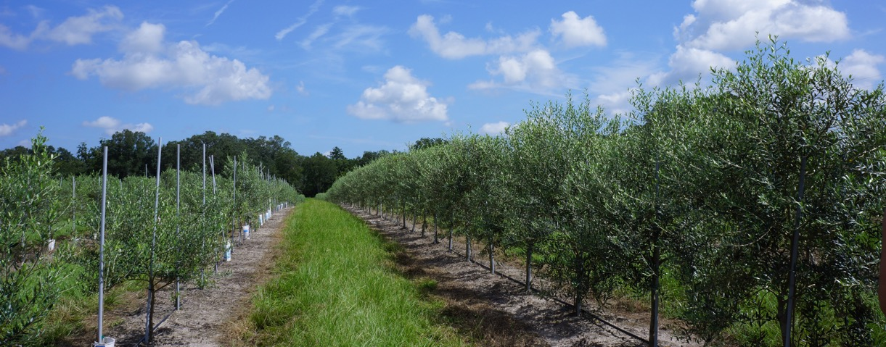
An Arthropod Survey of North Central Florida Olive Groves: The Potential of Olives as a New Specialty Crop
Eleanor Phillips
Sandra Allan
Jennifer Gillett-Kaufman

Slide 2
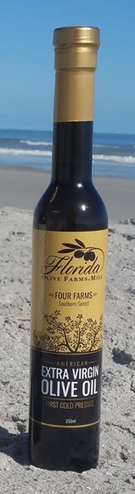
Olives…in Florida?
Grown in Florida for 100+ years as ornamentals, small plantings
80-90% Arbequina cultivar
  Primarily oil
2017 = ~300 ha → 2018 = ~1,000 ha
Establishment of commercial plantings = potential for pests
North central Florida ideal neotropical climate for pests
Sandy soils ideal, atypical climate for olive

Slide 3
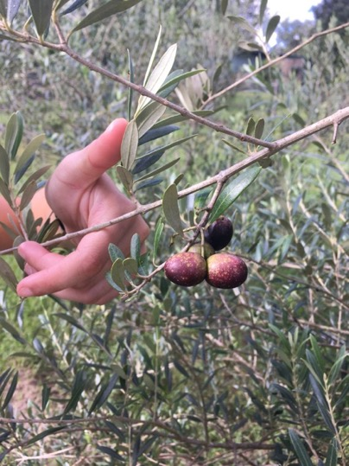
Objectives
Conduct arthropod pest survey in Florida olive
Determine the main insect pests
Determine if any invasive pests present in the groves

Slide 4
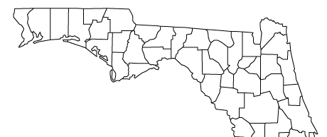
Methods: Research Groves
Four inland, north central Florida olive groves surveyed
February 2017 – November 2018
4 ha survey area in 3 groves, 1 ha survey area in 1 grove (13 ha total)

Slide 5
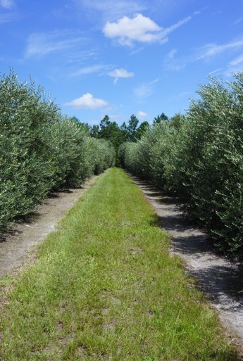
Methods: Research Groves
Relatively young groves
High-density or super high-density
Cultivars
  Primary = Arbequina
  Pollinizers = Arbosana, Koroneiki, Luca, Mission
Drip irrigation
Bamboo pole, wire trellis, PVC pipe for tree support

Slide 6
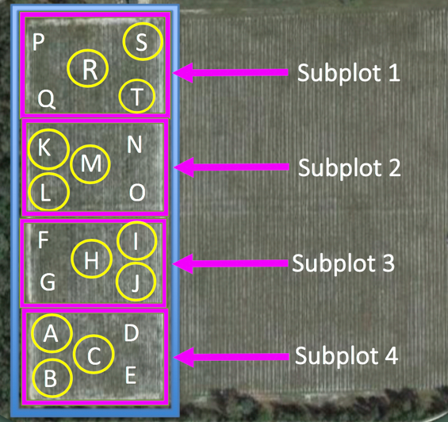
Methods: Sampling Layout in Groves
5/5 locations:
  Branch tapping
  Bark brushing
  Yellow and blue sticky cards
3/5 locations per subplot:
  Sweep netting
  Tree observations
  Stink bug traps
  Olive fruit fly traps

Slide 7
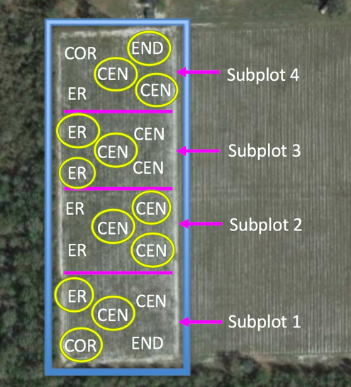
Methods: Spatial Identifiers Within Groves
CEN = center site
COR = corner site
END = end of row site
ER = edge of row site

Slide 8
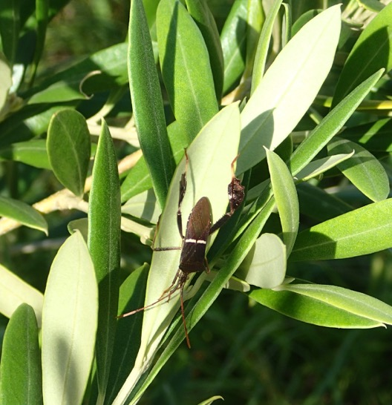
Methods: Statistical Analysis
General Linear Model (Proc GLM) ANOVA run in SAS
  Data were square root transformed (+0.1)
  Data analyzed with means tests
Independent variables
  Spatial
  Temporal
  Trap characteristics
Sandra A. Allan

Slide 9
Results
Close to 700,000 arthropods identified to different taxonomic levels
  Pests and beneficial arthropods identified
Overview main pests of concern

Slide 10
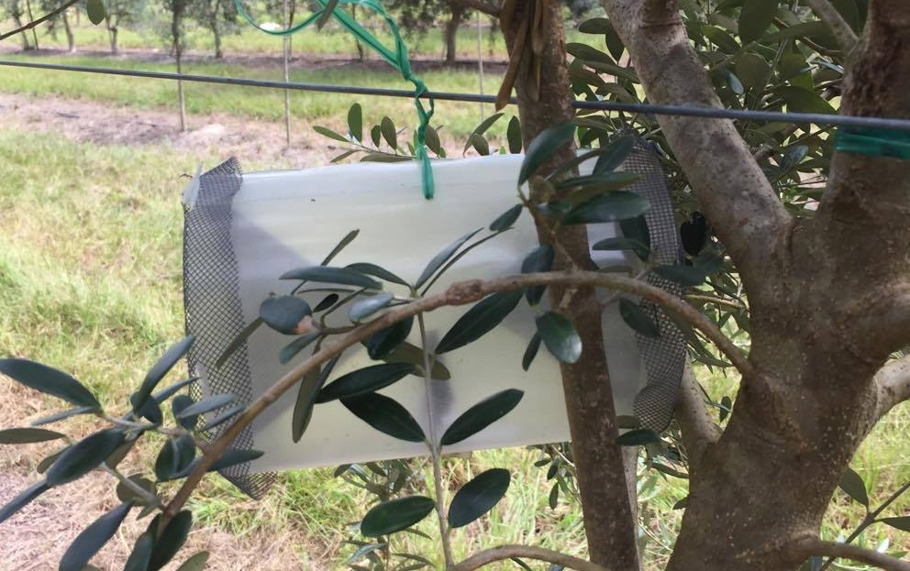
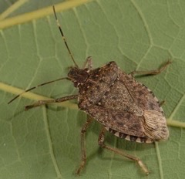
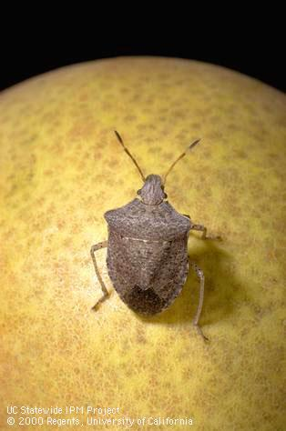
Results: Stink Bug Traps
Monitoring done for native and invasive stink bugs
  Brown marmorated stink bug lure + green stink bug lure
  Consperse stink bug lure
No invasive stink bugs identified
  Brown marmorated
  Consperse
1.
2.
Lyle Buss, UF/IFAS

Slide 11
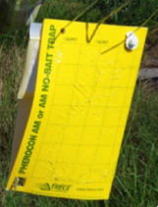
Results: Olive Fruit Fly Traps
Majority Diptera
  Trapping in corner locations recommended
No Bactrocera oleae (olive fruit fly)

Slide 12
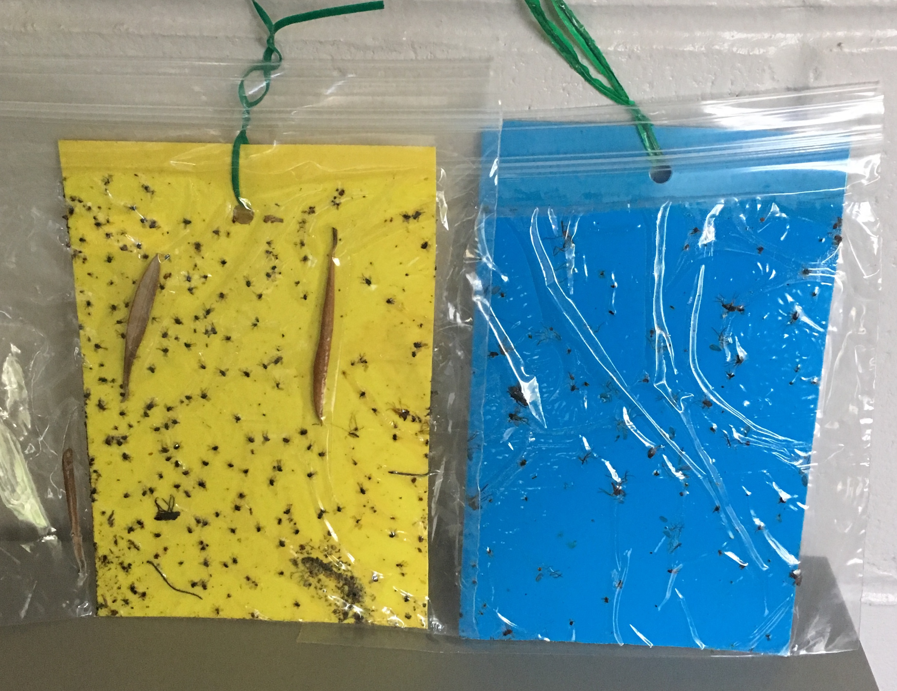
Results: Yellow and Blue Sticky Cards
Thysanoptera
  Frankliniella species most common flower pest species

Slide 13
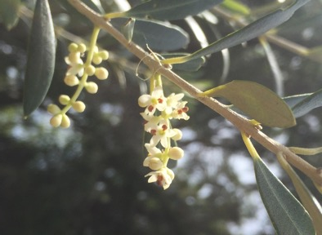
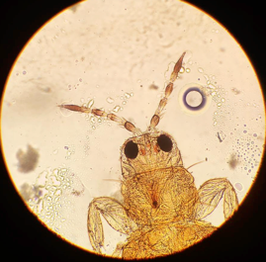
Results: Yellow and Blue Sticky Cards
  Tap flowers onto white piece of paper to see these insects
  Florida flower thrips, Frankliniella bispinosa, most common

Slide 14
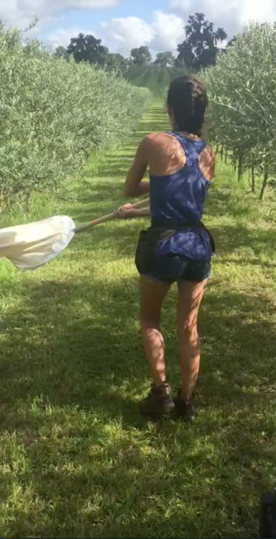
Results: Sweep Netting and Observation
Sweep netting
No major pests of olive identified in sweep net samples
Tree observation
Scale insects
  Ants
Rustic sphynx hornworms
Crambidae shootworms
Fall webworms
Tip binders

Slide 15
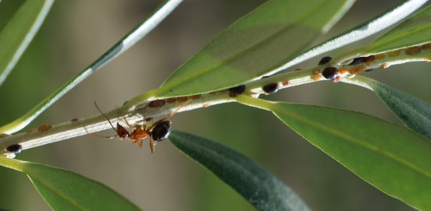
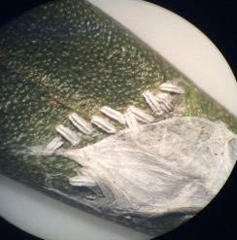
Results: Pests of Concern
Black scale, Saissetia oleae
  Ants often seen tending scales– control of ants important
Other scales found
  Citrus scale, Unaspis citri

Slide 16
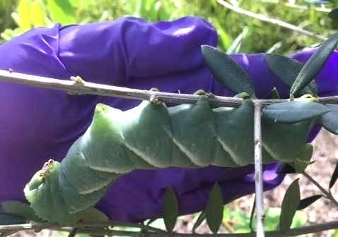
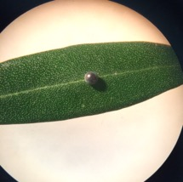
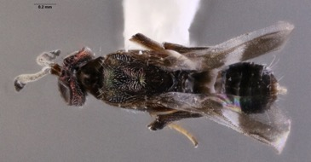
Results:
Pest of Concern
Manduca rustica – rustic sphynx
Quick and severe defoliation
Evidence of parasitism
Dr. Elijah Talamas
FDACS/DPI
Anastatus reduvii
(Hymenoptera: Eupelmidae)

Slide 17
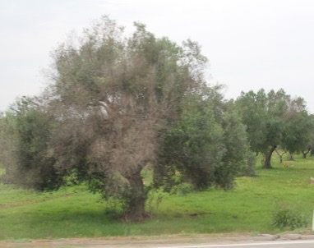
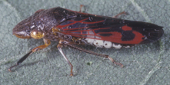
Results: Multiple Methods – Pest of Concern
Glassy-winged sharpshooter, Homalodisca vitripennis
Attracted to yellow
Potential to spread plant pathogen Xylella fastidiosa subspecies pauca
  Causal agent of Olive Quick Decline Disease in Italy –Cercopidae vector
  Disease currently not detected in U.S.
Lyle J Buss, UF
Whitney Elmore, UF/IFAS
Italian olive

Slide 18
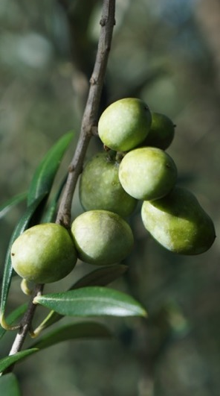
Results: Fruit Collection
No organisms emerged from collected fruit
Holding for arthropod emergence
  Ongoing

Slide 19
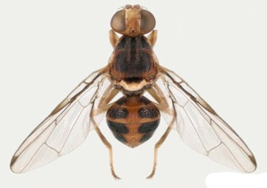
Conclusions: Invasive Pests
Olive fruit fly
None identified! ☺
No flies emerged from fruit samples
Brown marmorated stink bug
None in baited stink bug traps or other methods
Natasha Wright, FDACS
Lyle Buss, UF/IFAS

Slide 20
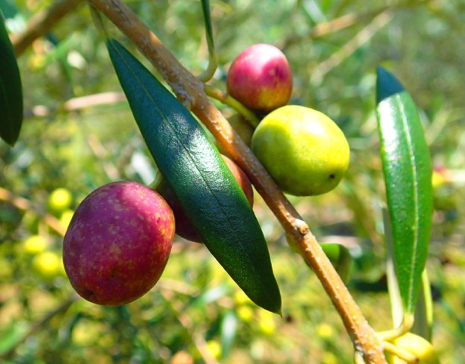
Ongoing monitoring – invasive fruit pests
  Olive fruit fly and brown marmorated stink bug
    Neither detected in my survey
    Olive fruit fly has been intercepted on infested plant materials – precautions important (FDACS 2014)
    Brown marmorated stink bug has been reported as introduced by human activity in peach systems in south central Florida (Penca and Hodges 2018)
Sandra A. Allan

Slide 21
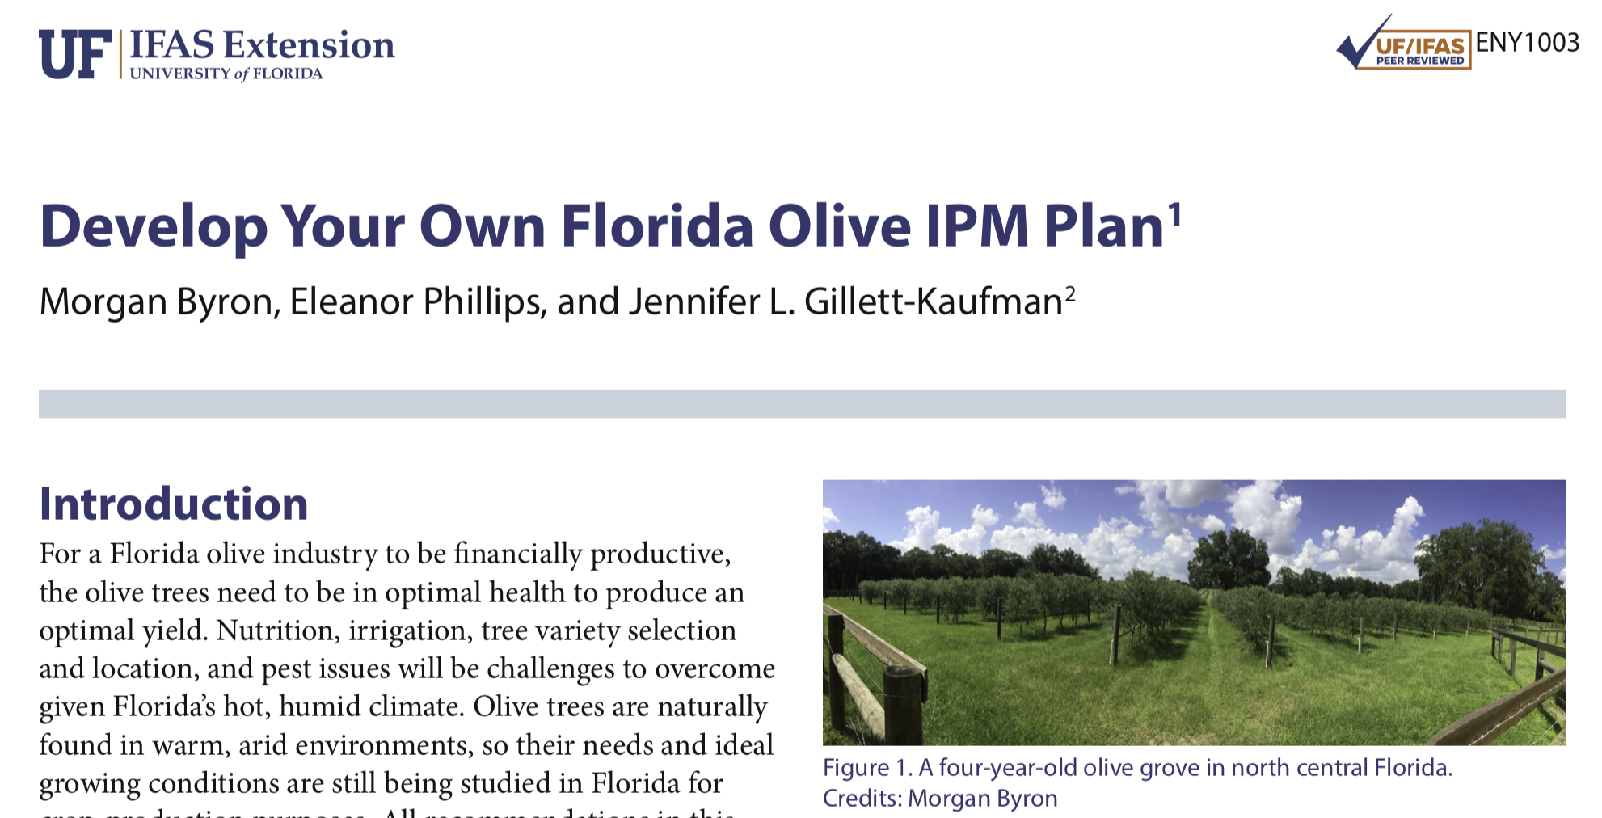
Management Recommendations
  “Develop Your Own Florida Olive IPM Plan”
    IPM = Integrated Pest Management
    https://edis.ifas.ufl.edu/pdffiles/IN/IN125100.pdf

Slide 22

Acknowledgements
Florida olive growers and farm managers
Lab mates: Dr. Morgan Byron and Dr. Haleigh Ray
Research assistants: Taryn Griffith, Carrie Suen, Angelina Nasthas, Jas Zhai, and Hannah Sholar
Insect ID: Lyle Buss, Dr. Gary Steck, Dr. Elijah Talamas, Oliver Keller, and Kyle Schnepp
Peer Editors
UF Entomology and Nematology Department
Doctor of Plant Medicine Program
Family and Friends
Funding: Florida Department of Agriculture and Consumer Services FDACS-SCBG No. 024064 Project No.48

Slide 23
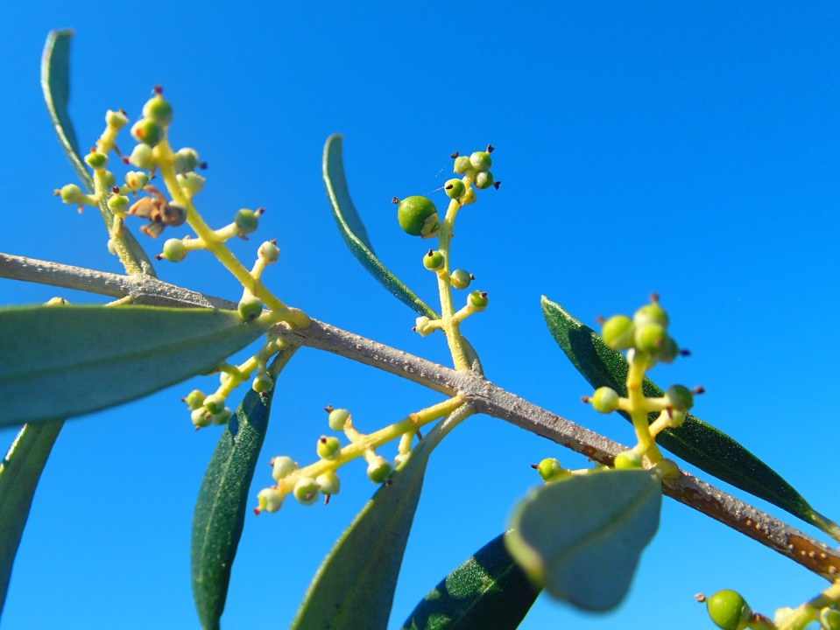

Questions?
Sandra A. Allan

