Slide 1
NORTH FLORIDA OLIVE FIELD DAY
Tom Oleson
St. Johns County

Slide 2
TOM OLESON ANCIENT CITY OLIVES
“Cabbage and potatoes was not enough so I planted olive trees in Hastings!”
Tom Oleson, FL Olive Grower

Slide 3
Grove
Grove Planted in 2003
Size: Approximately 1.5 acres
Location: Hastings, FL (West of St. Augustine)
Number of trees: 100-200 at any given time
Varieties: Arbequina, Chemlali, Moroccan Picholine, Coratina, Leccino, Koroneiki
Spacing: 14’ on center
Fertigation – Mini Sprinklers

Slide 4
Tom Oleson/ Ancient City Olives
Cabbage and potatoes was not enough so
I planted olive trees in Hastings in 2003
100-200 trees in grove at any one time.
27 varieties including Arbequina, Chemlali, Moroccan Picholine, Coratina, Leccino, Koroneiki.
14 ft on center
Sandy soil with high water table
Fertigation with individual mini-sprinklers
Re-planted after big freeze of Dec. 2010

Slide 5
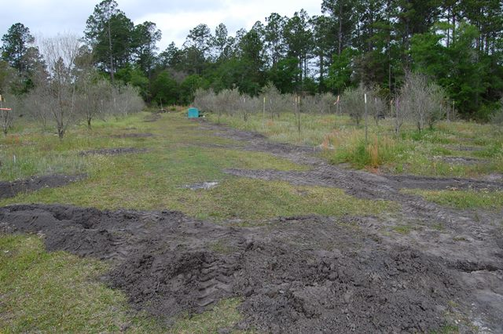
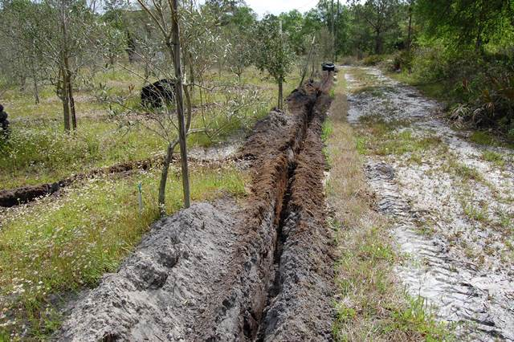
Trials and Triumphs
December 2010 freeze
required replanting
Flooding required excavation due to high water table

Slide 6
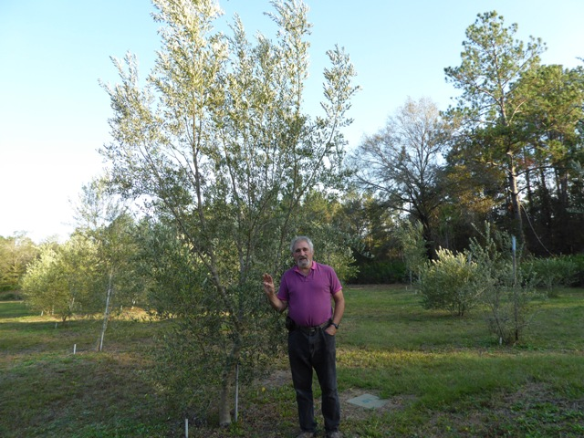
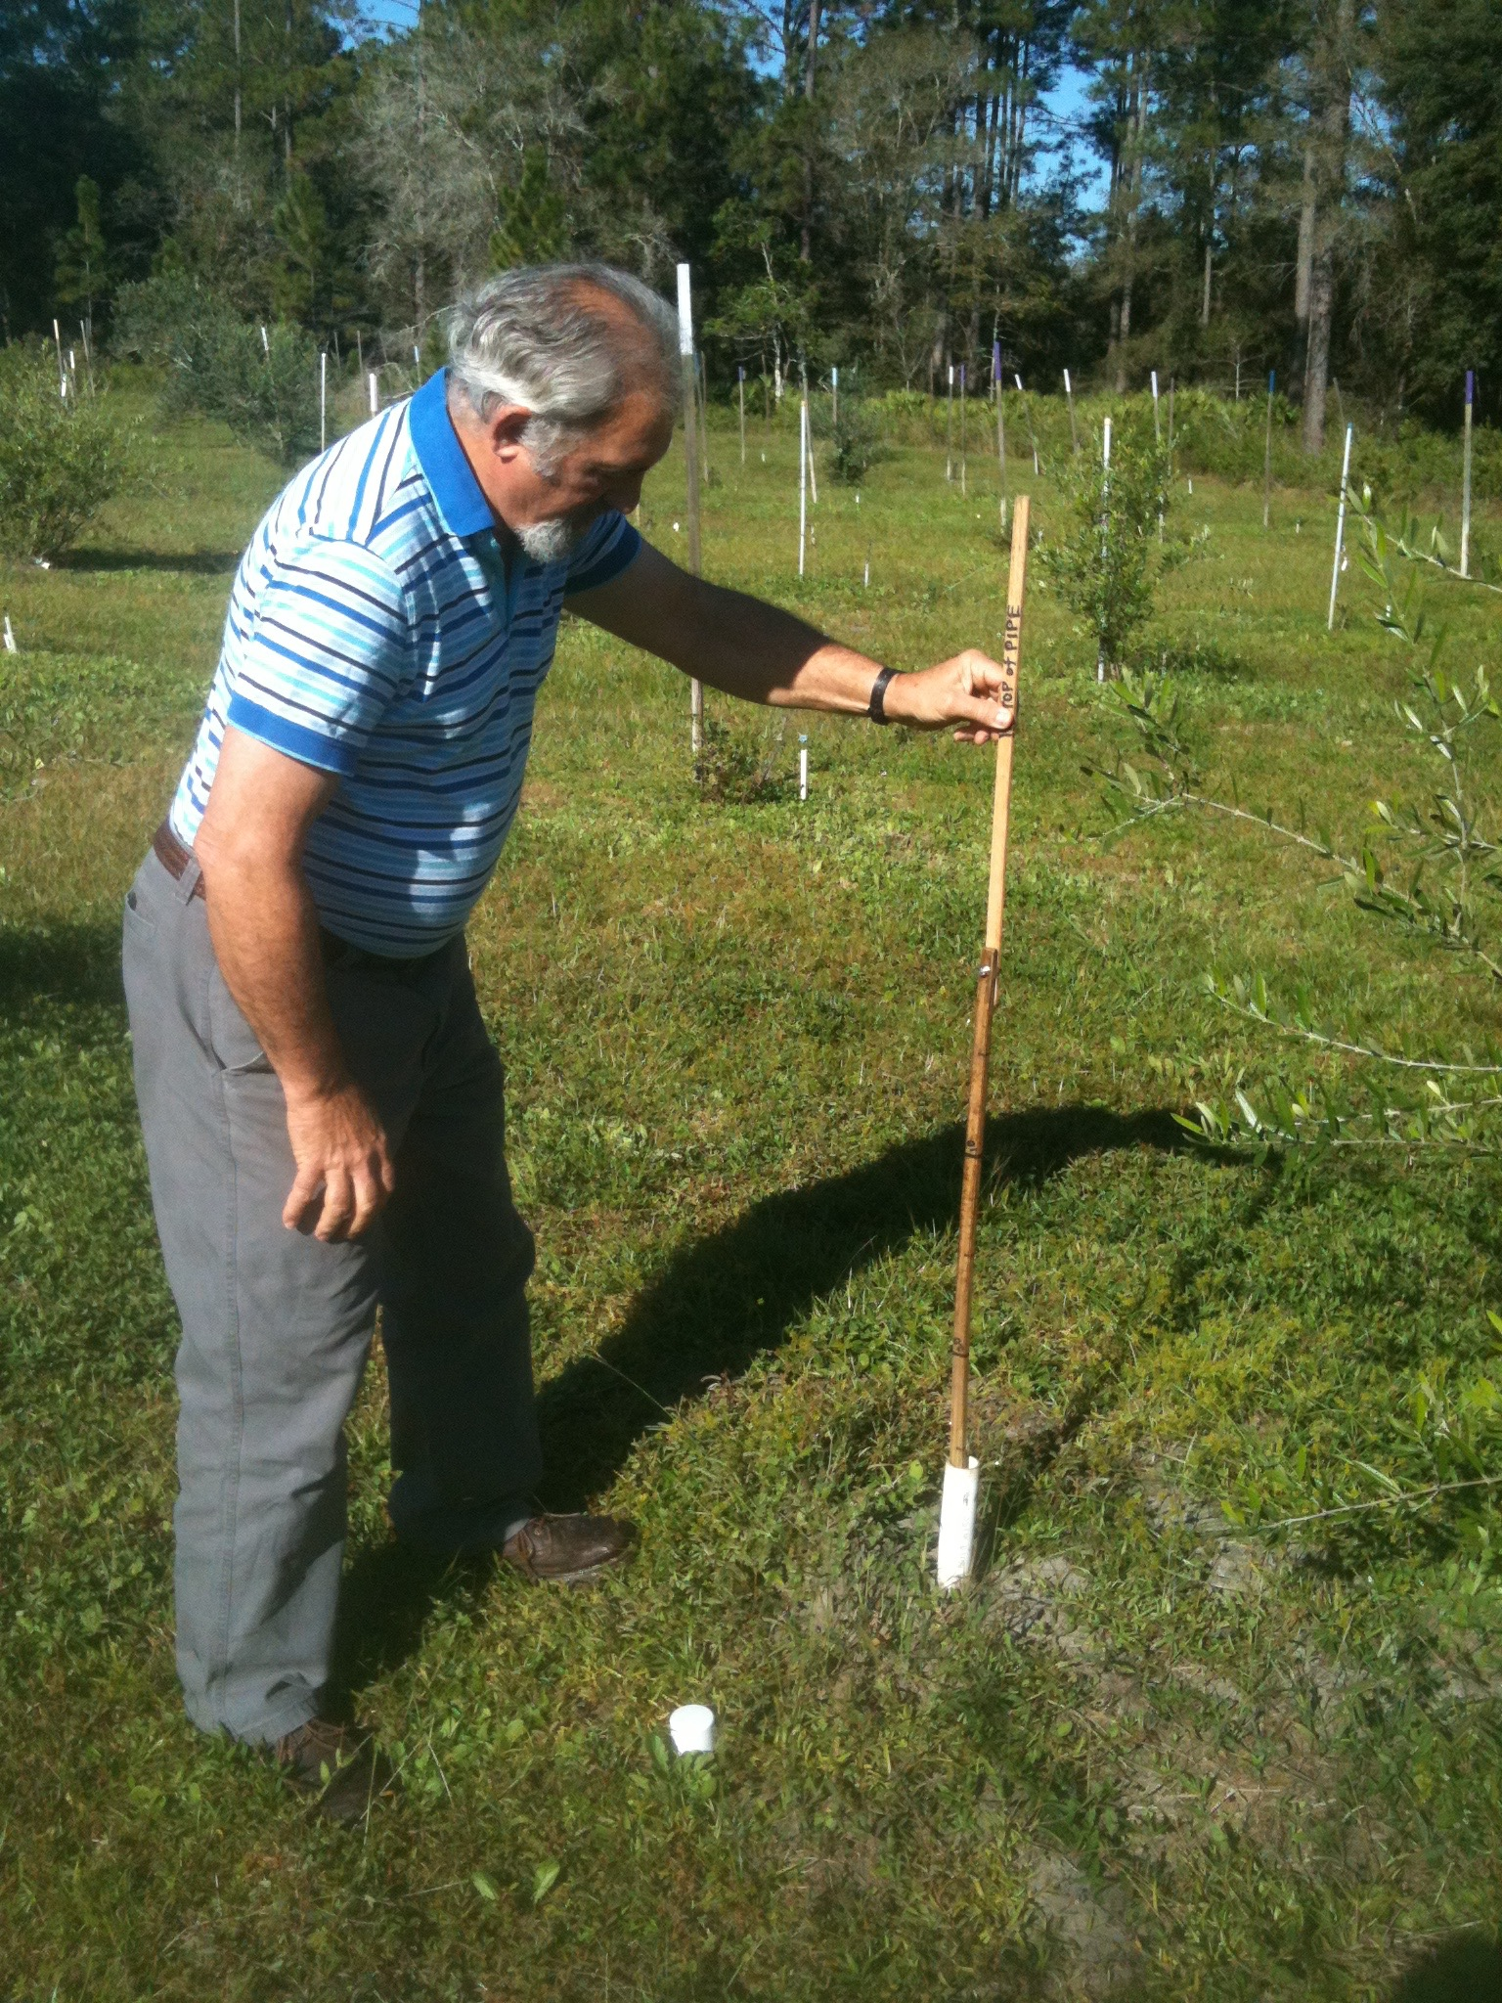
Tom at Work
3 year old Chemlali
Checking Water Table

Slide 7
Recommendations
Select land with good drainage
Always bed up – raise soil level at least 12”
Spot irrigation was not enough – consider gp/m
Broadcast fertilizer in a wide pattern
Use 8-8-8 at 600 lbs./acre
Set trees with slow release fertilizer, bagged soil and compost with native sand
Watch for Stink Bugs – degrade harvest quality
Keep extra trees in pots as back up

Slide 8
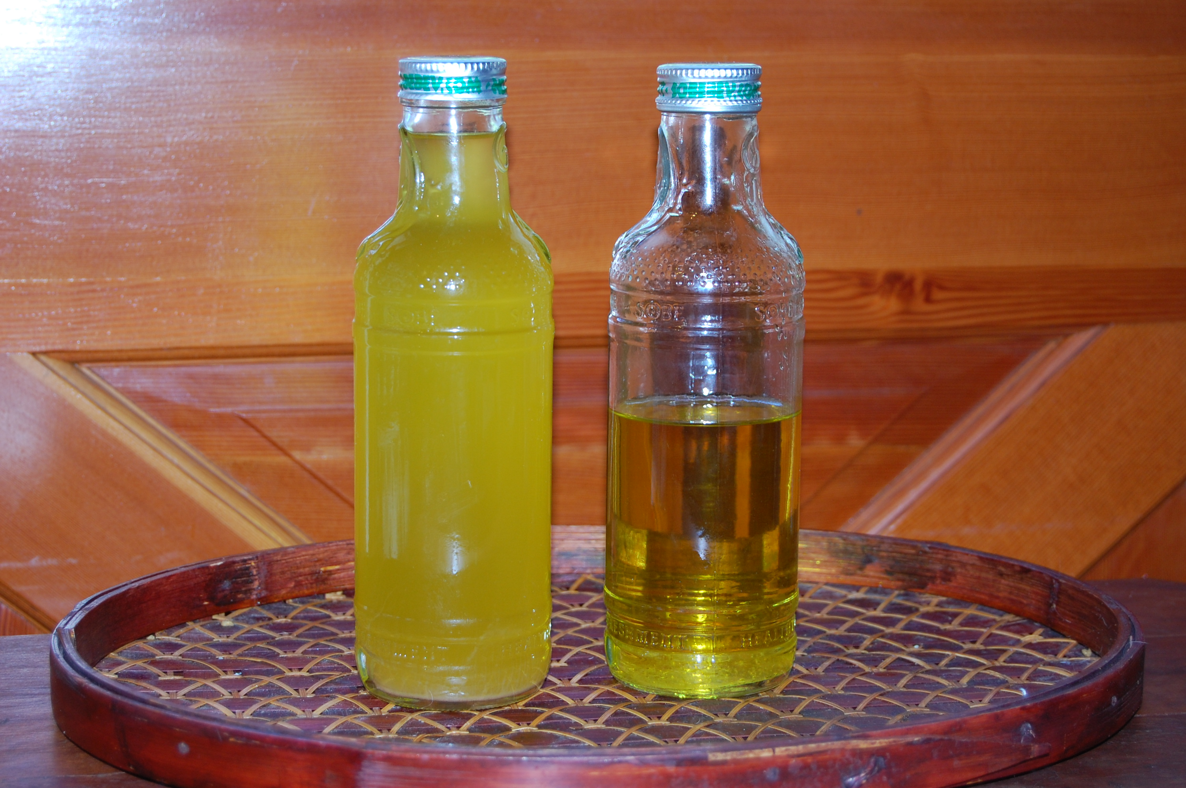
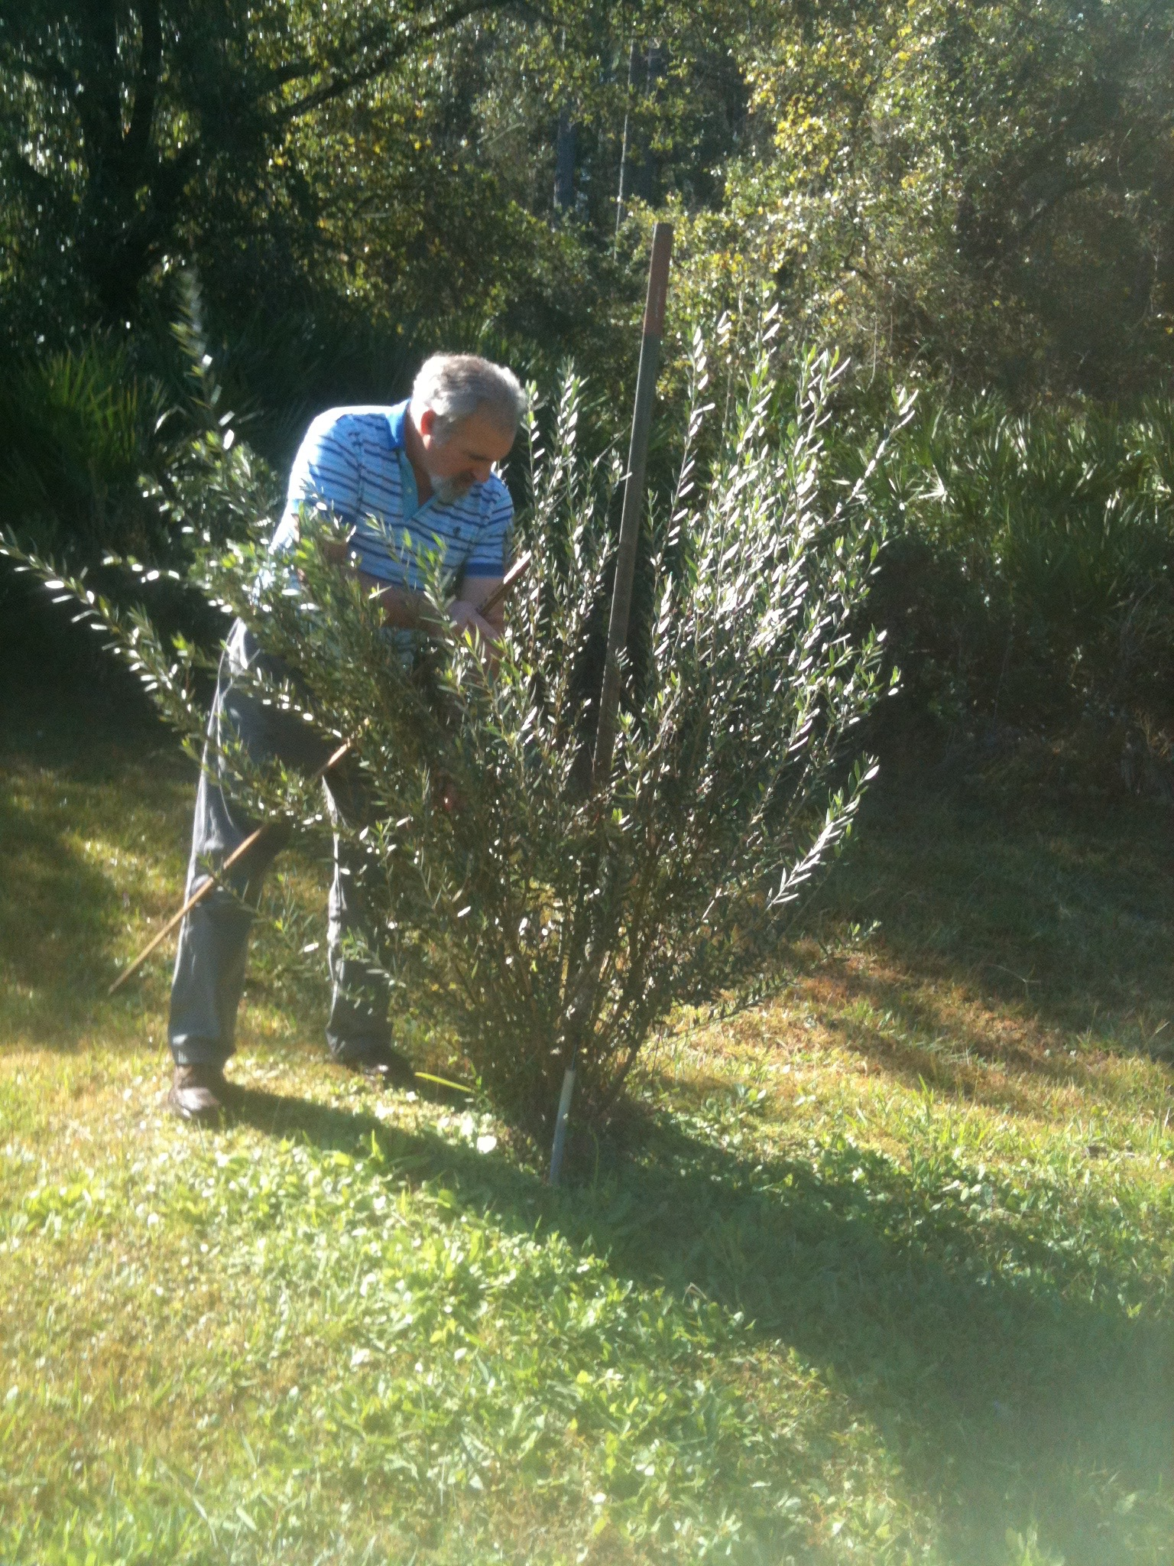
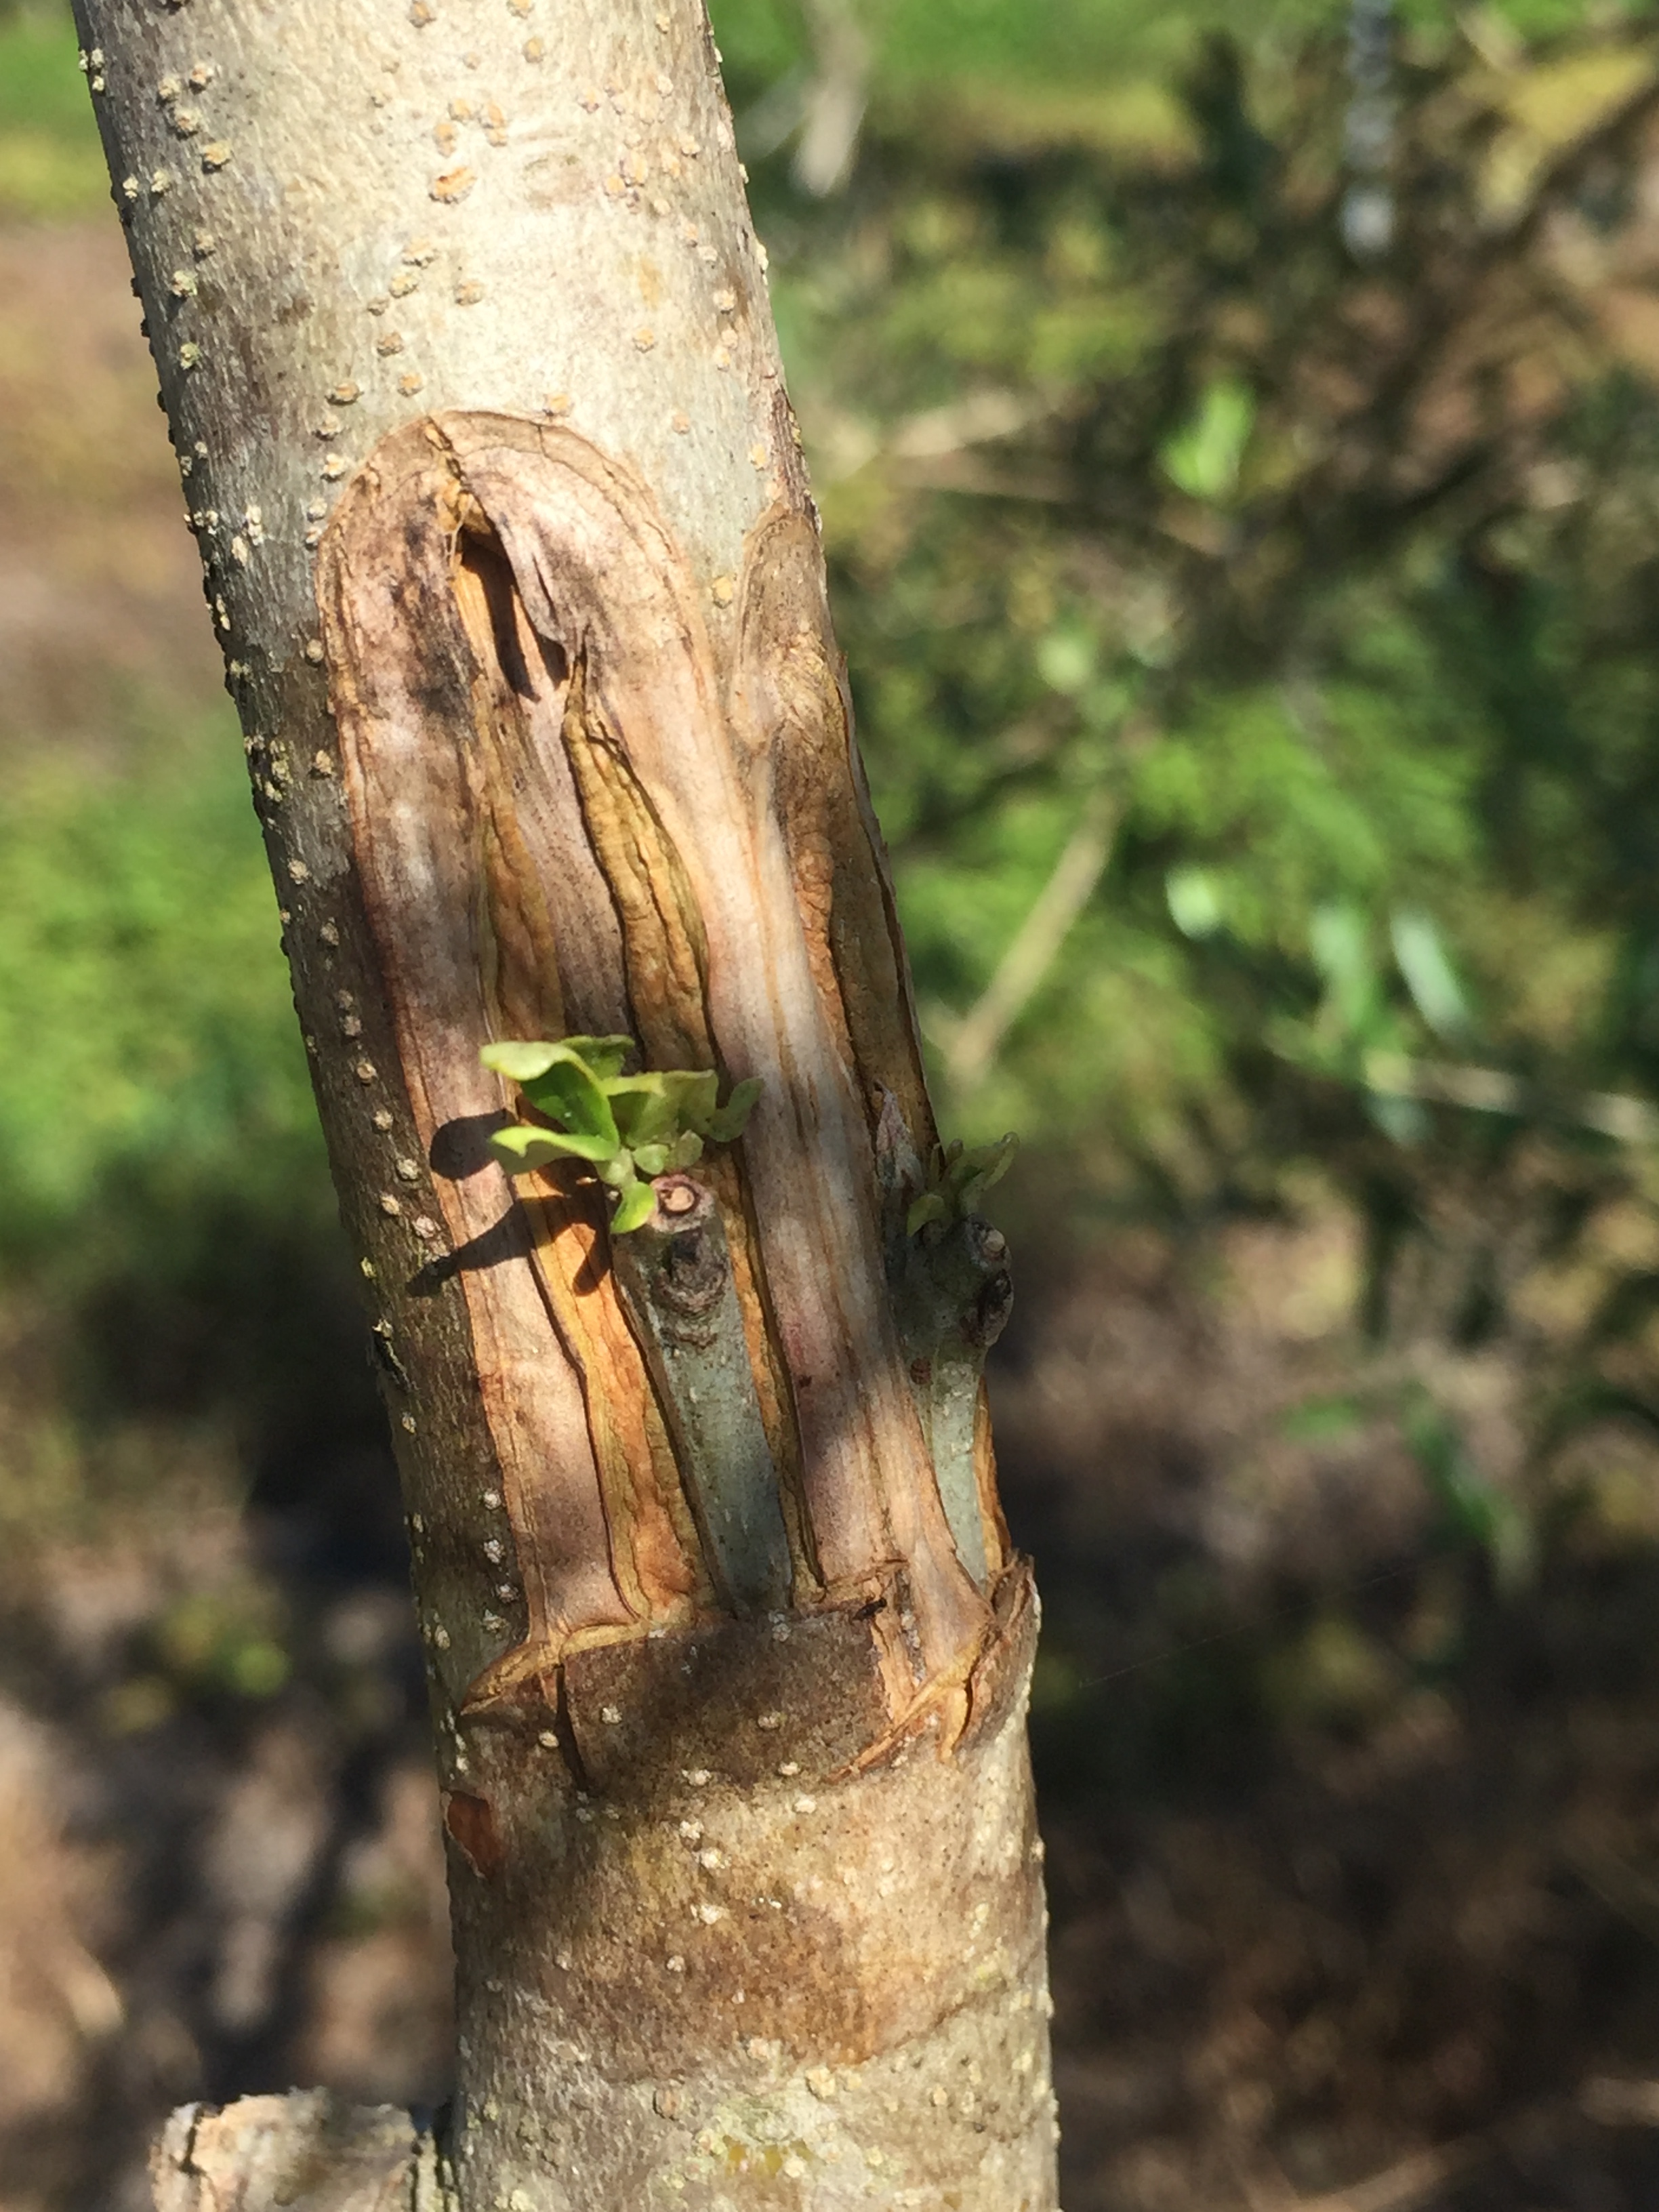
<insert grove photos>
Tom Oleson – Ancient City Olive Oil
shipscarver@hotmail.com

