Slide 1
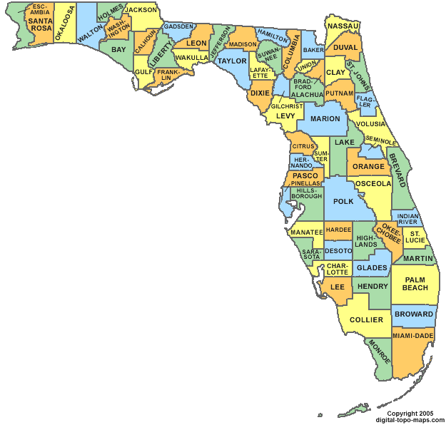
Low Chill Research – Rooting and Grafting
NORTH FLORIDA OLIVE FIELD DAY-2019
© 2019 FLORIDA OLIVE COUNCIL, LAA All rights reserved.

Slide 2
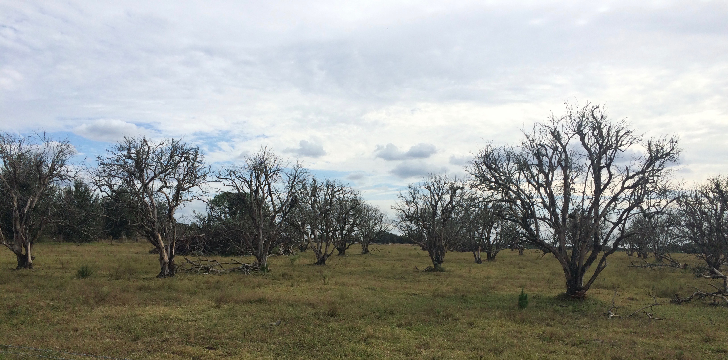
Citrus Crisis
Citrus Production Down by 50% over past 20 years
2000 = 200 million boxes 2018 70 million boxes
300k acres of abandoned groves
Most impact in south Central Florida (Hardee, Desoto, Highlands, Polk)
Significant loss of revenue and jobs
$10 Billion lost revenue – 7,000 Jobs gone
$300 million spent on HLB research-no cure has been found

Slide 3
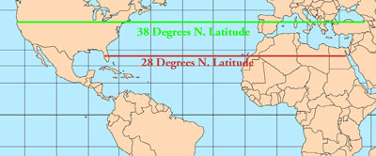
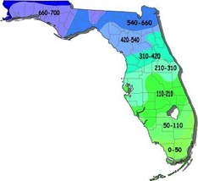
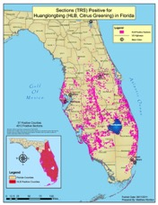
Low Chill Olive Cultivar Development Partners: UF-IFAS, Hardee County, USDA, U. of Cordoba (Spain)
Goal: Discover/develop an olive variety requiring less than 100 chill hours.
28 degrees N. L
Research Process
2016
Cultivar research in Spain and Croatia
Establish partnerships for research execution
2017
Graft and Root 27 Olive Varieties (MENA, Levant, South America)
Establish and Fund Pioneer Plant Lab at UF-IFAS Dept. of Hort.
2018
Graft and Root 40 Olive Varieties (MENA, Levant, South America)
© 2019 FLORIDA OLIVE COUNCIL, LAA All rights reserved.

Slide 4
Hardee County Test Grove

Slide 5
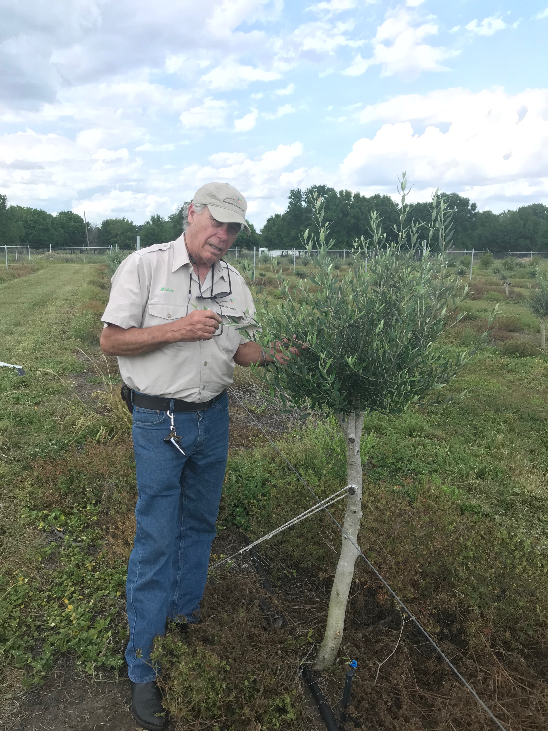
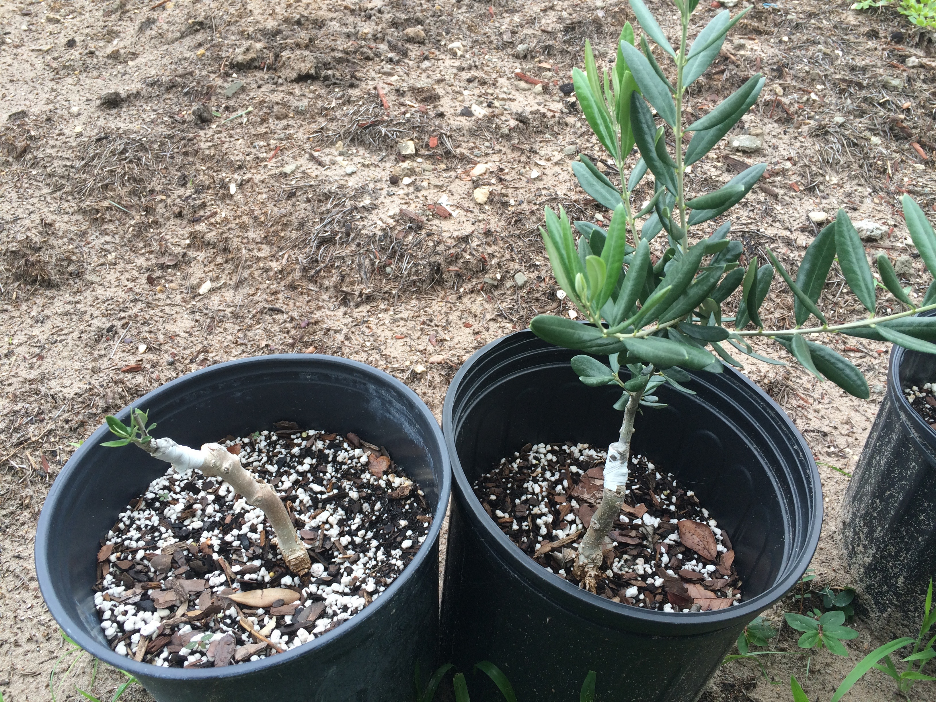
Left – Grafted Azapa (Chile) at Hardee County
Above – Levantika-Soltana (grafted specimen used on Dalmatian Coast)

Slide 6
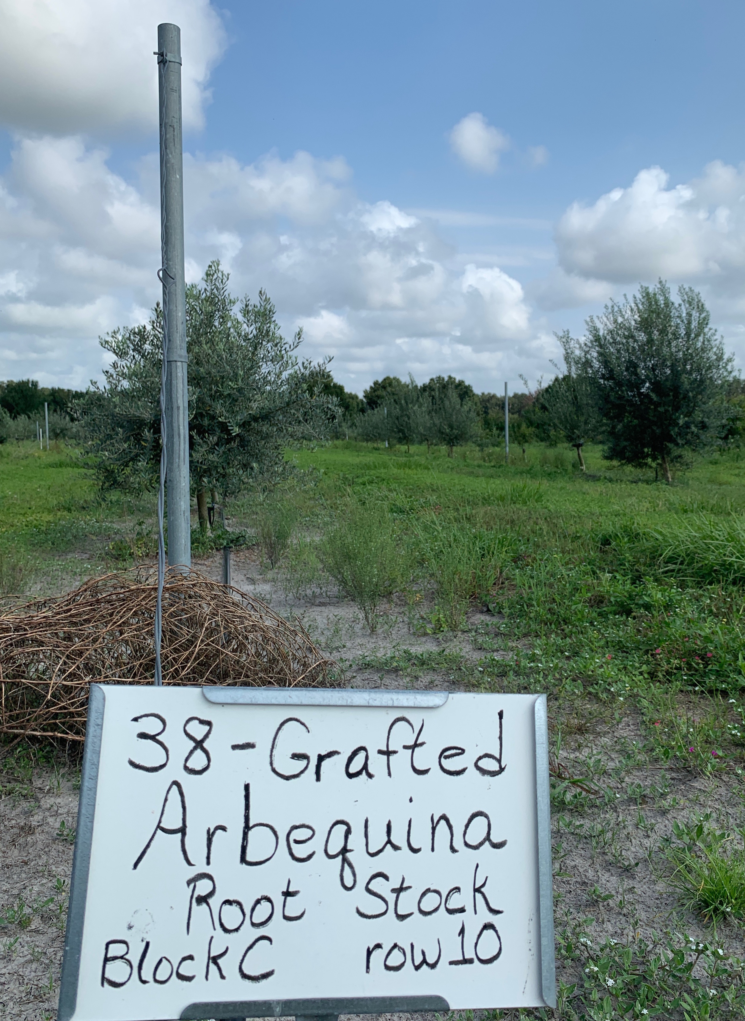
Hardee County Grove
Research grove (1000 olive trees) established 2017
Primary varieties included many common varieties in addition to MENA varieties
Hurricane damage (2017) overcome by repositioning trees
Various applications of fertilizer and water under review to optimize growth

Slide 7
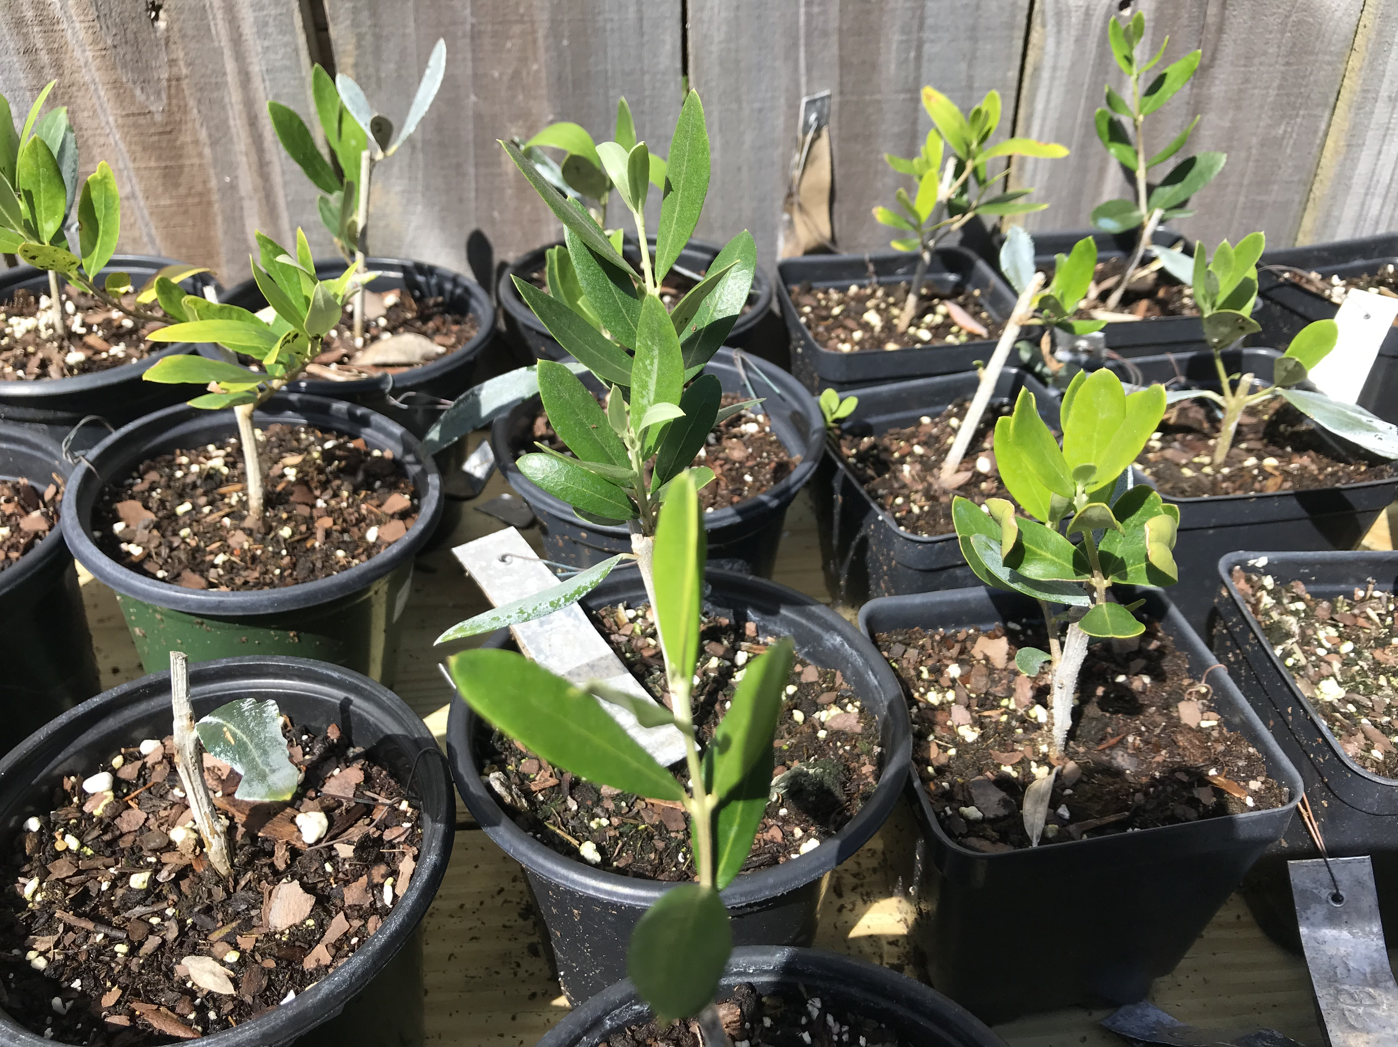
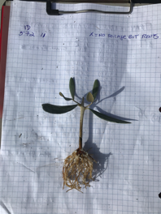
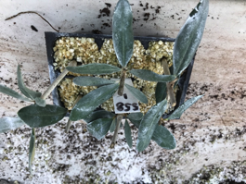
Rooting Process
40 cultivars from Middle East/North Africa secured from USDA germ plasm
5 cuttings from each variety were prepared using IBA solution – dipped for 8 seconds.
Cuttings were placed in pure pearlite and set under a misting system
After 6 weeks approximately 60 percent of cuttings were rooted

Slide 8
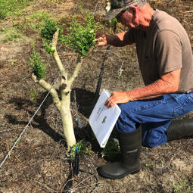
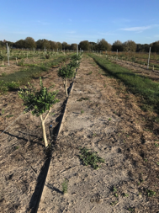
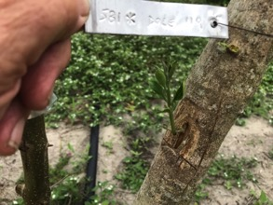
GRAFTING PROCESS
Research Hypothesis: Grafting MENA varieties onto existing mature olive at Hardee may provide evidence of flowering in low chill environment
MENA varieties were grafted onto 100 olive trees at Hardee County research farm
Earlier grafting attempts failed due to hurricane damage and small diameter of cuttings
Subsequent grafting of 40 varieties of larger diameter were successful
© 2019 FLORIDA OLIVE COUNCIL, LAA All rights reserved.

Slide 9
How Can You Help?
Contact your local UF-IFAS agent and ask for information on olive growing
Provide a letter of support for UF-IFAS 2020 Specialty Crop Block Grant for Olives
Join and support the Florida Olive Council
<WWW.FLORIDAOLIVE.ORG>

Slide 10
Thank You.

