Slide 1
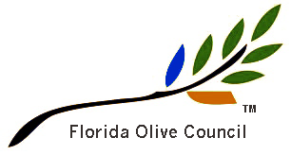
Growing Olives in Florida
© 2017 Florida Olive Council, LAA. All Rights Reserved

Slide 2
Who Are We?
The Florida Olive Council, LAA
Established in 2011
Conduct olive research and development
Partners: University of Florida/ Industry
Track 42 groves throughout the State
What We Want?
Investors for Olive Projects In Florida
Investors for Low-Chill Olive Cultivar Development and Licensing
© 2017 Florida Olive Council, LAA. All Rights Reserved

Slide 3
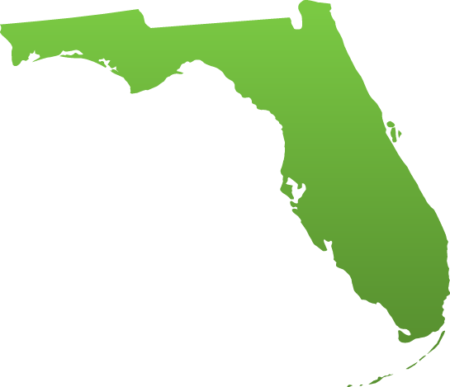
Historic FL Olive Production
1565 – Spanish Landing at St. Augustine
1865 – Fernandina – Stickney Plantation
1750 – Ormond Bch – Turnbull Plantation
1935 – Tampa – Gibson Plantation
© 2017 Florida Olive Council, LAA. All Rights Reserved

Slide 4
Current Florida Olive Sites
FOC-Active Monitor Sites (11)
UF-IFAS Research Grove – Jay
Mueller Grove – Marianna
Oleson Grove - Hastings
Carter Grove – Live Oak
FOC Propagation Research Facility – La Crosse
UF-IFAS Research Grove – Gainesville
UF-IFAS Research Grove – Citra
UF-IFAS Research Grove – Ocala
Williams Grove – De Leon Springs
Lykes Brothers Grove – Lake Wales
Mosaic Corp. Grove – Bowling Green
Other Groves (31)
Thomas Grove - Milton
Mazzarino Grove - Pensacola
King Grove - Destin
Harrell Grove - Chipley
Haselberger Grove - Yulee
Various Small Groves - St. Augustine
Roberts Timber Test Plot - Palatka
Hannah Grove - Live Oak
Jackson Grove - Live Oak
U/K Grove <30-10-59N 82-42-30W> - Lake City
Kent Grove - Worthington Springs
Allen Grove - Gainesville
Clugston Test Plot - Gainesville
Davenport Test Plot - Gainesville
Zarur Test Plot - Gainesville
Valenza Grove - Citra
Weaver Grove - Citra
McGinley Test Plot - South Marion County
Cloud Grove - Dunellon
Barth Grove - Bushnell
White Grove - Brooksville
Penderson Grove - Clermont
Daniell Grove - Clermont
Yuque Grove - Groveland
Williams Grove - De Leon Springs
Stilling Grove - New Smyrna Bch
Venrick Grove - Orlando
Mack Grove - Lakeland
Kamiya Test Plot - Bradenton
Sproul Grove - Martin County
Sowers - Singer - Lee County
© 2017 Florida Olive Council, LAA. All Rights Reserved

Slide 5
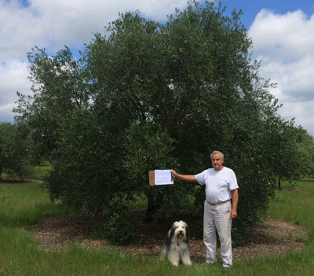
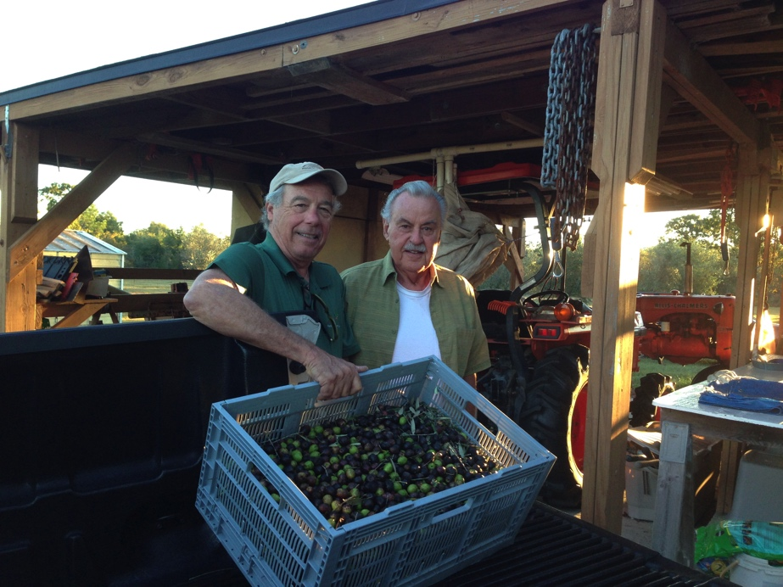
Mueller Grove - Marianna
400 trees on 5 acres – 15-20 year old trees
Frantoio, Leccino, Coratina, Mission, Manzanilla
© 2017 Florida Olive Council, LAA. All Rights Reserved

Slide 6
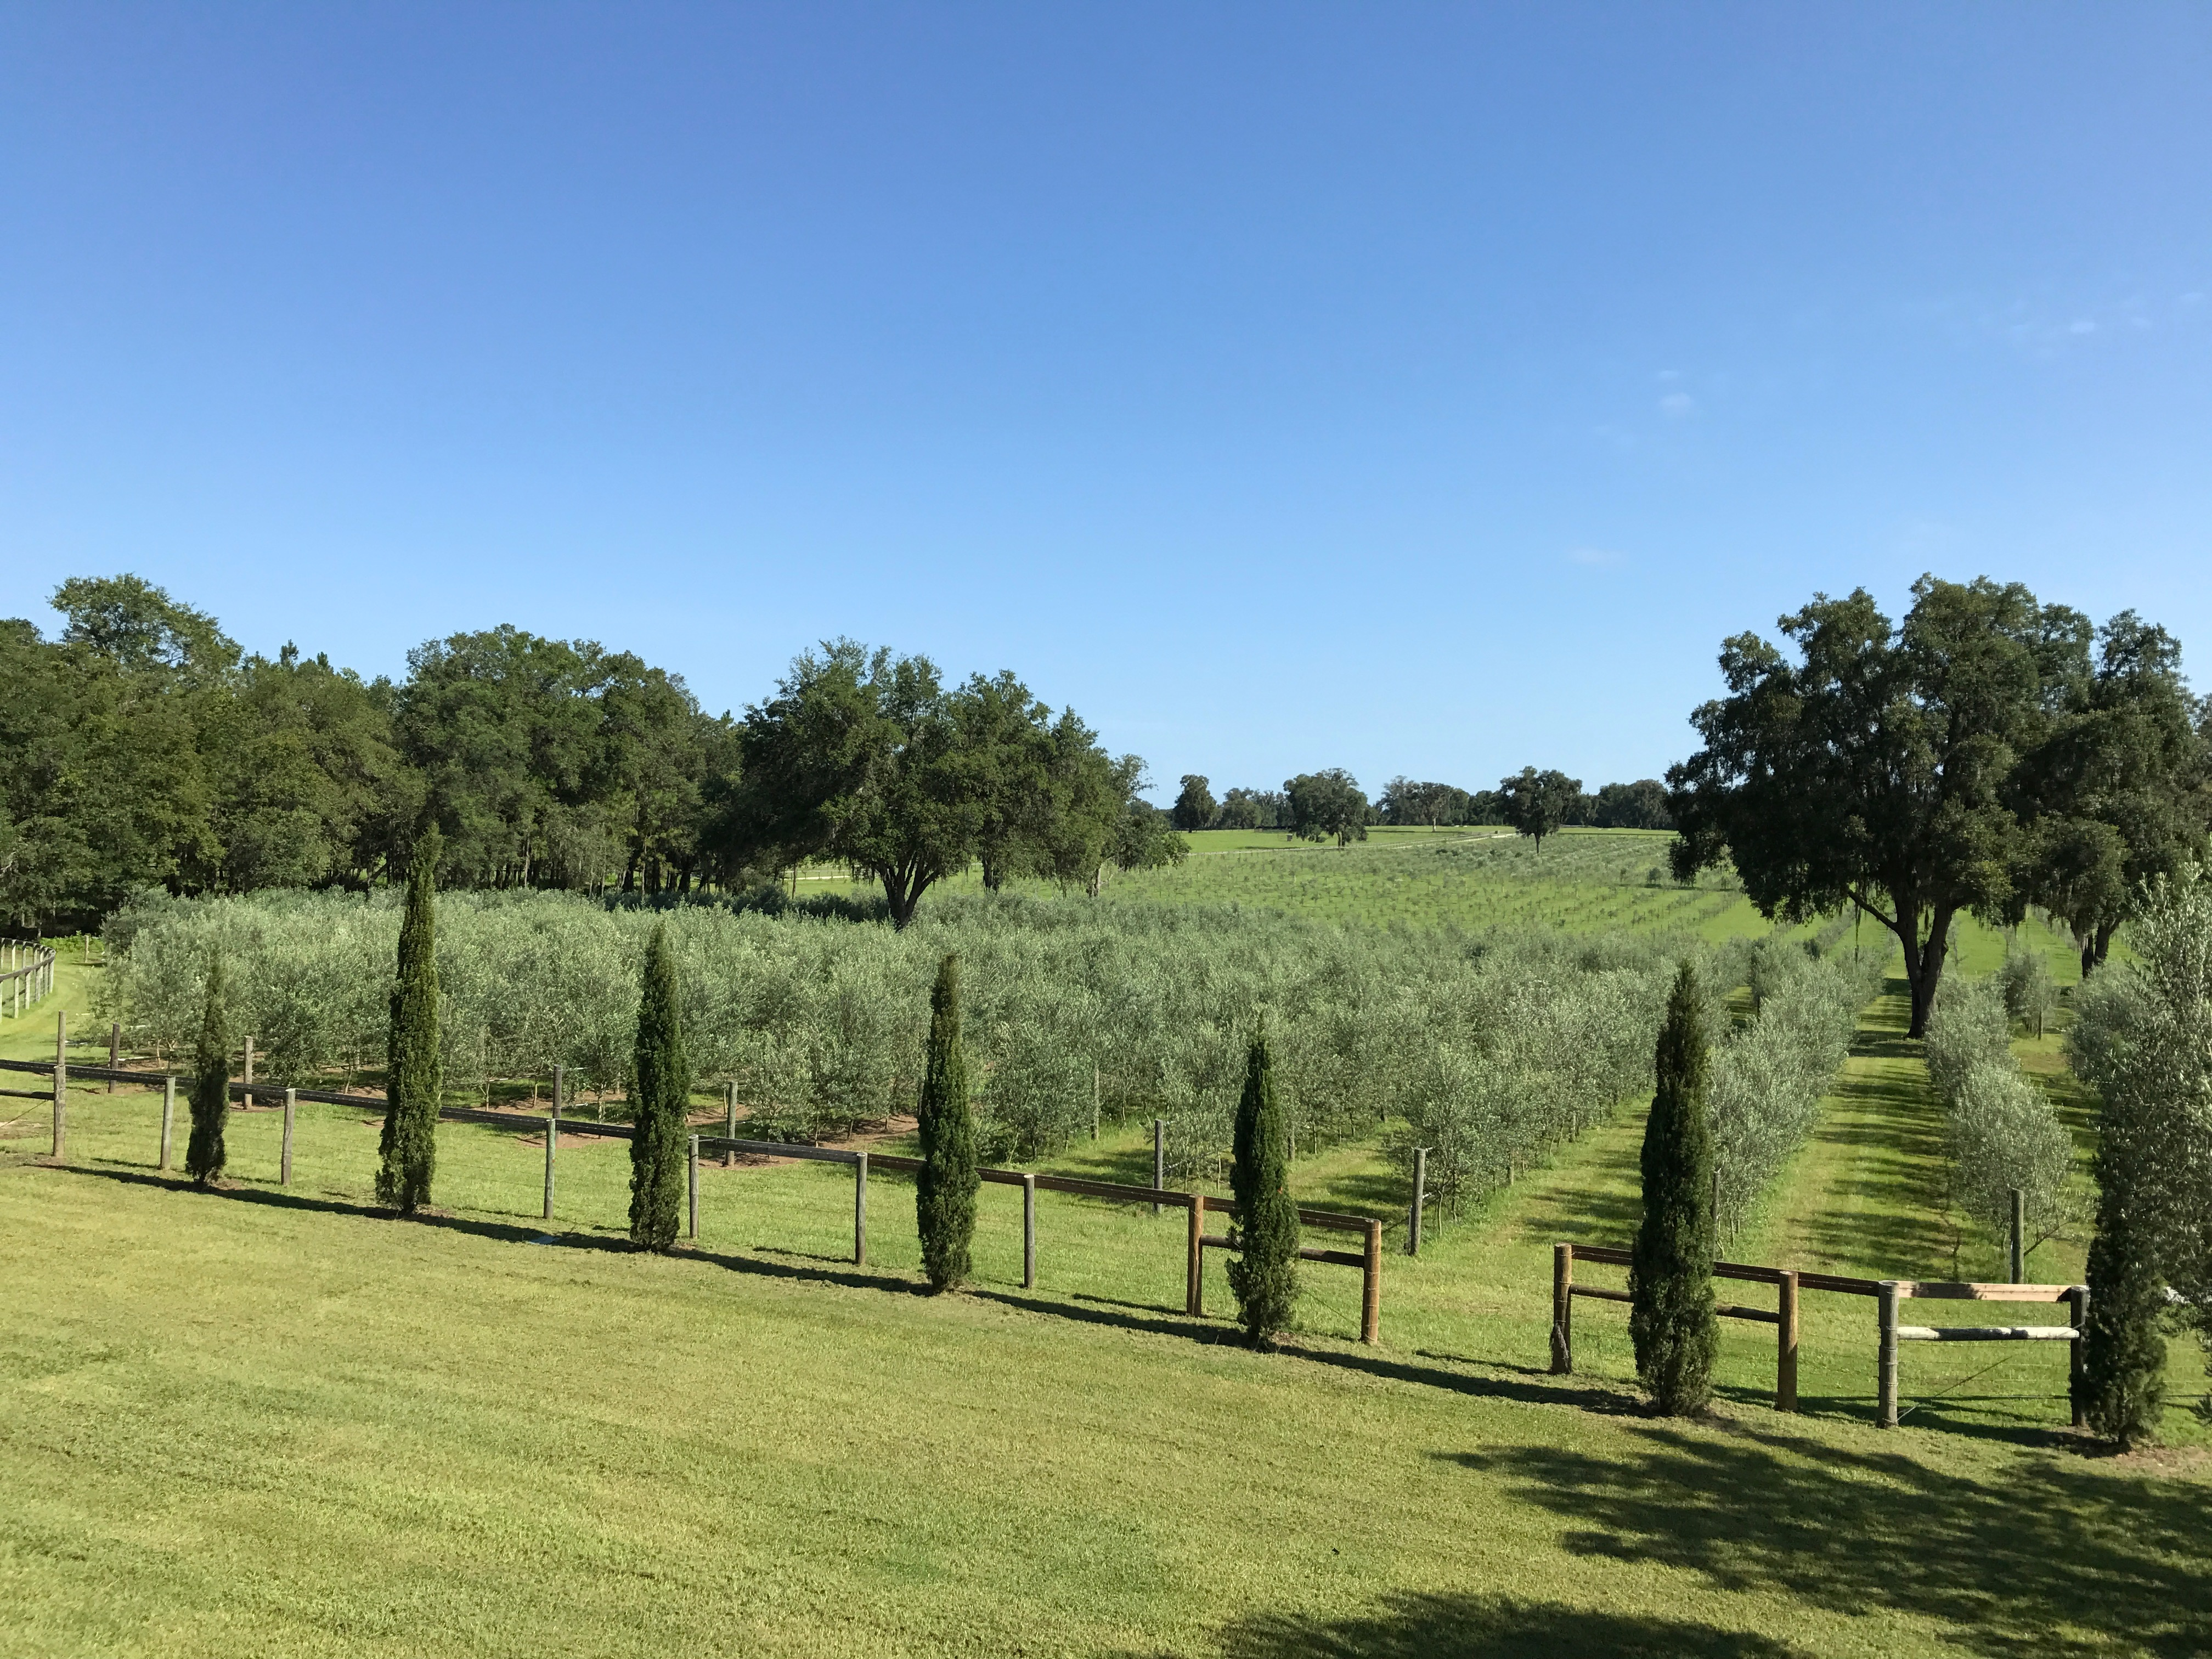
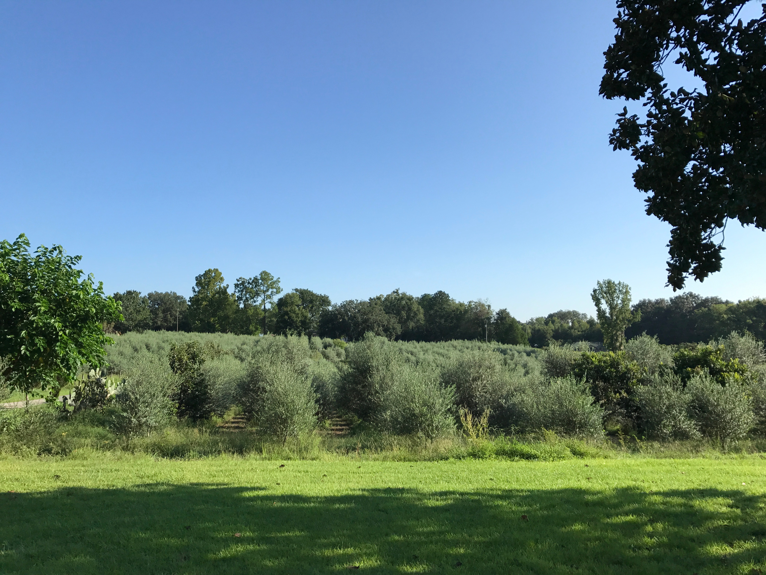
Clear Creek Farm & Mill
Ocala, Fl.
10 ha
Arbequina, Mission, Lucca, Frantoio, Manzanilla, Koroneiki.
Guy Burgetto Farm
Gainesville, Fl.
2 ha
Arbequina, Arbosana, Koroneiki.
© 2017 Florida Olive Council, LAA. All Rights Reserved

Slide 7
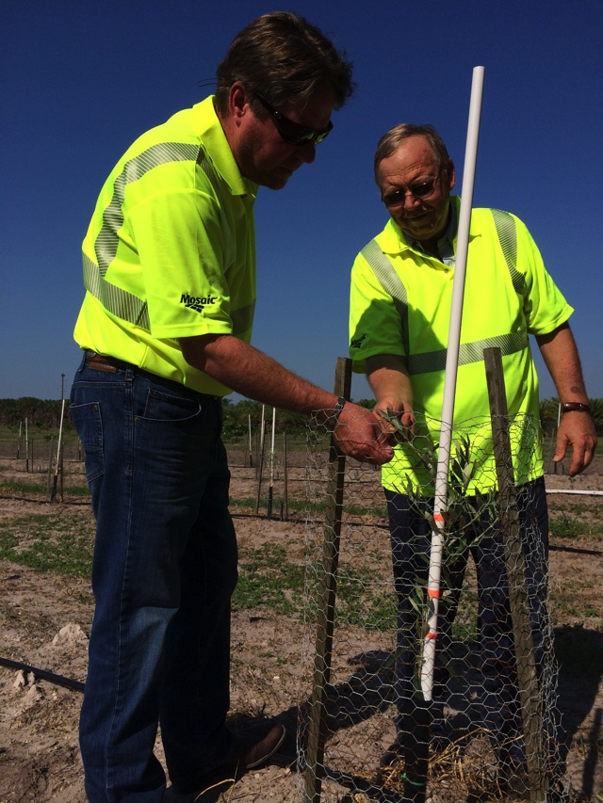
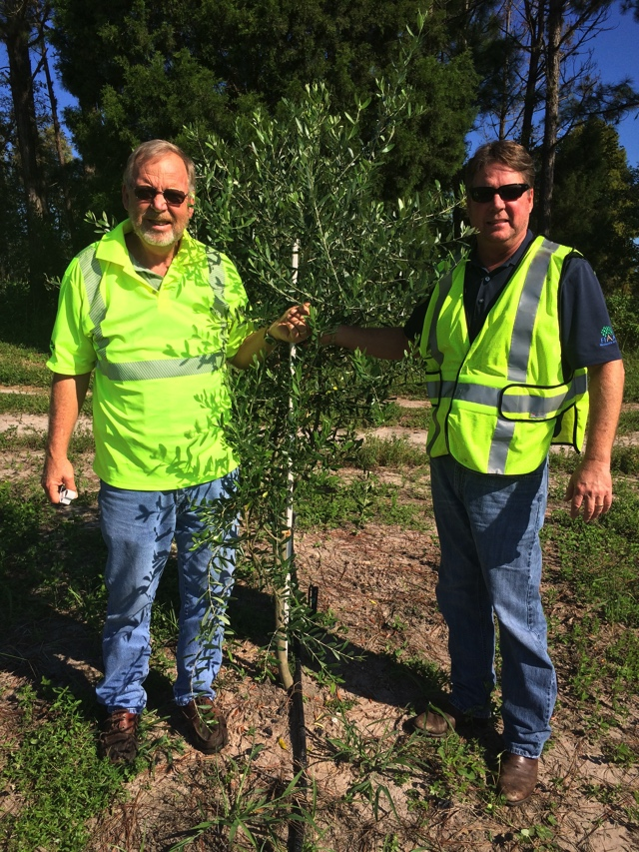
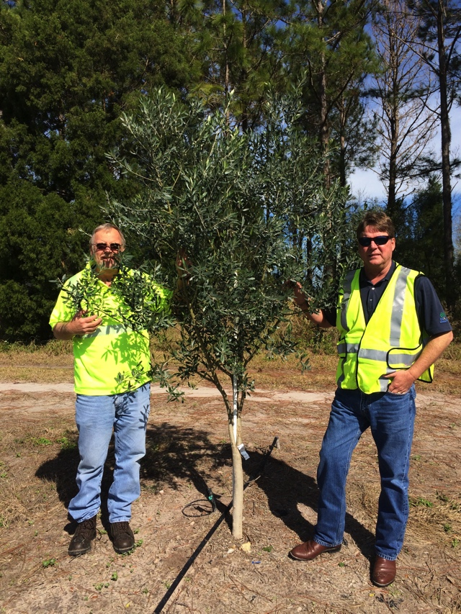
Olive Tree Growth on Reclaimed Phosphate Land – Hardee County
2014
2015
2016
© 2017 Florida Olive Council, LAA. All Rights Reserved

Slide 8
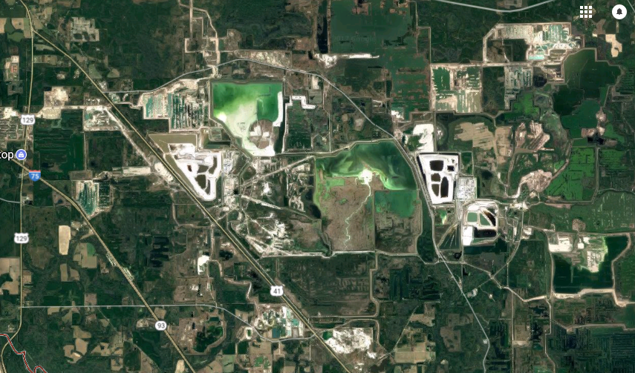
8000+ PCS Corp - Hamilton County, FL
8,000 acres of land
© 2017 Florida Olive Council, LAA. All Rights Reserved

Slide 9
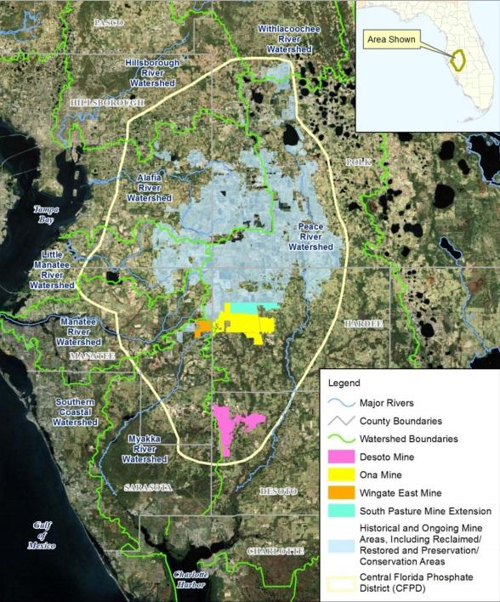
10,000+ Acres Mosaic Hardee County
© 2017 Florida Olive Council, LAA. All Rights Reserved

Slide 10
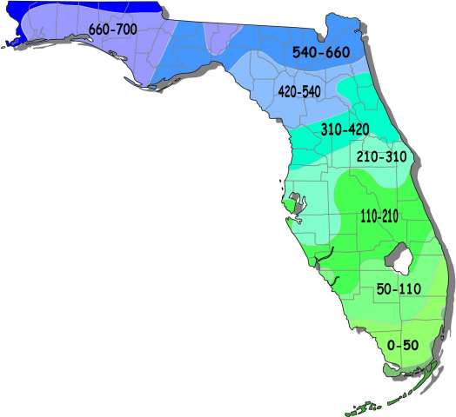
Featured Olive Cultivation Sites
Bainbridge, GA 1500 a HD – 2 yrs old
Cook-Redland Corp (Fr.)
Lakeland, GA – 300a HD 6 yrs old
Shaw Farms (US)
Marianna, FL - 5a LD 20 yrs old
Green Gate Grove (US)
Phosphate Re-Claimed Land
18,000+ acres available
Deleon Springs, FL 20a HD – 5 yrs old
Williams Grove (US)
*2.27a = 1 hectare

Slide 11
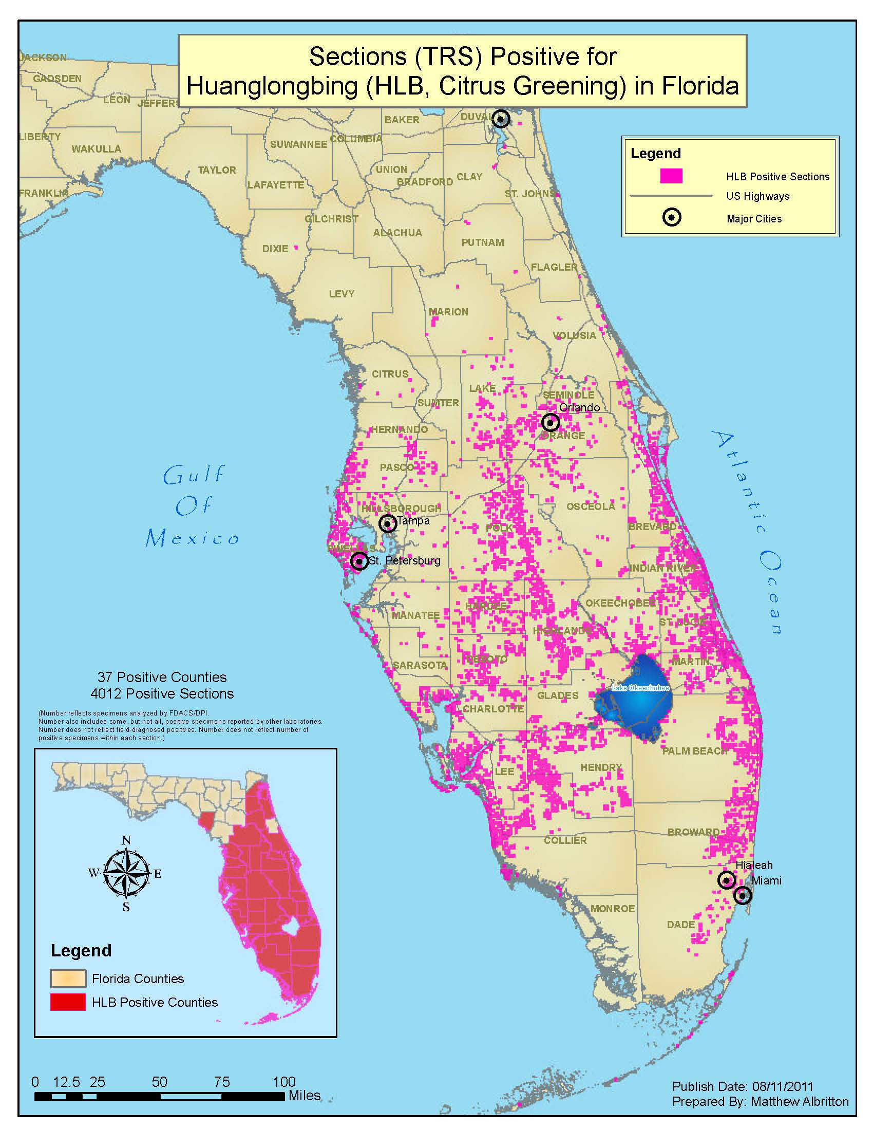
HLB Infected Groves (2012)
Florida Historic Chill Map
28° 30’N
27° 30’ N
COST OF HLB
$7B Economic Loss
30k jobs lost
$250m research expended
2017 = no viable solution
© 2017 Florida Olive Council, LAA. All Rights Reserved

Slide 12
Florida Olive Sites – Historic Chill
JAY (11-25/2-26)
2004 – 210 hours
2005 – 381 hours
2006 - 329 hours
2007 – 364 hours
2008 – 403 hours
2009 – 417 hours
2010 – 113 hours
2011 – 236 hours
2012 – 513 hours
2013 – 501 hours
2014 – 272 hours
CITRA (11-25/2-26)
2004 – 491 hours
2005 – 518 hours
2006 – 324 hours
2007 – 288 hours
2008 – 475 hours
2009 – 759 hours
2010 – 684 hours
2011 – 348 hours
2012 – 349 hours
2013 – 349 hours
2014 – 463 hours
SEBRING (11-25/2-26)
2004 – 218 hours
2005 – 168 hours
2006 – 212 hours
2007 – 86 hours
2008 – 94 hours
2009 – 221 hours
2010 – 376 hours
2011 – 347 hours
2012 – 116 hours
2013 – 112 hours
2014 – 112 hours
© 2016 Florida Olive Council, LAA. All Rights Reserved

Slide 13
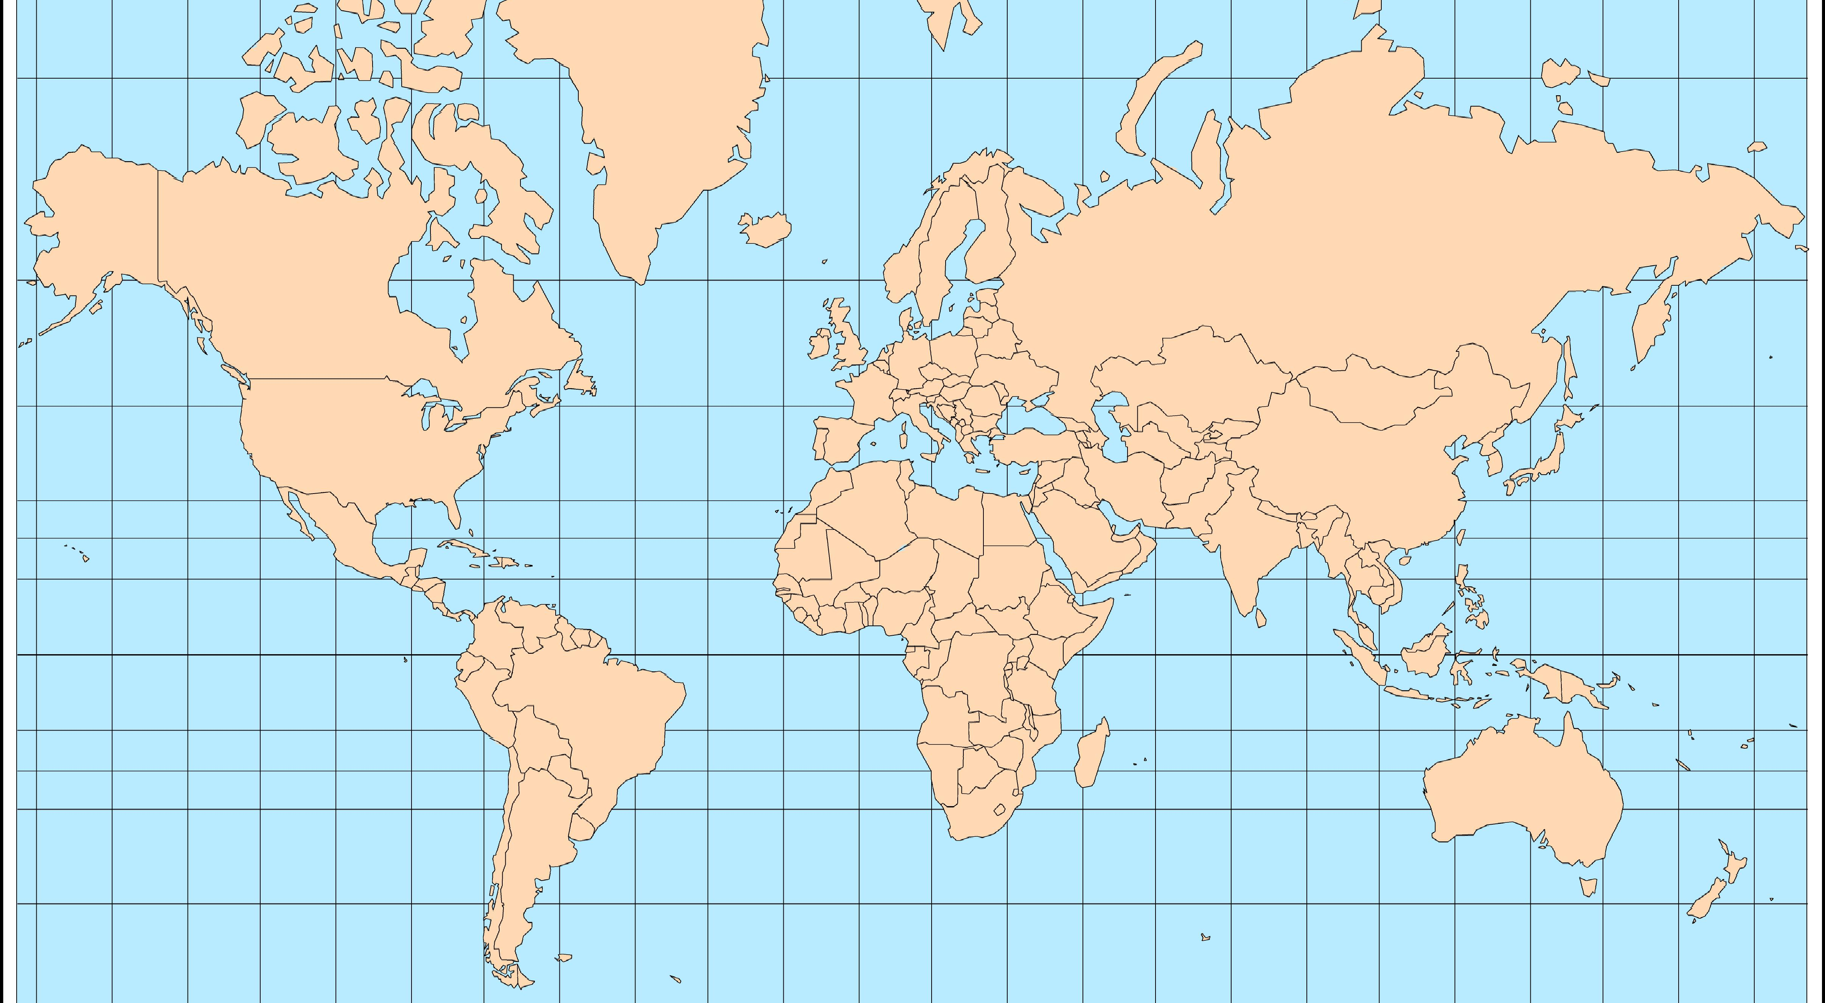
Low Chill Varieties Research
24 new varieties from USDA Germplasm Bank

Slide 14
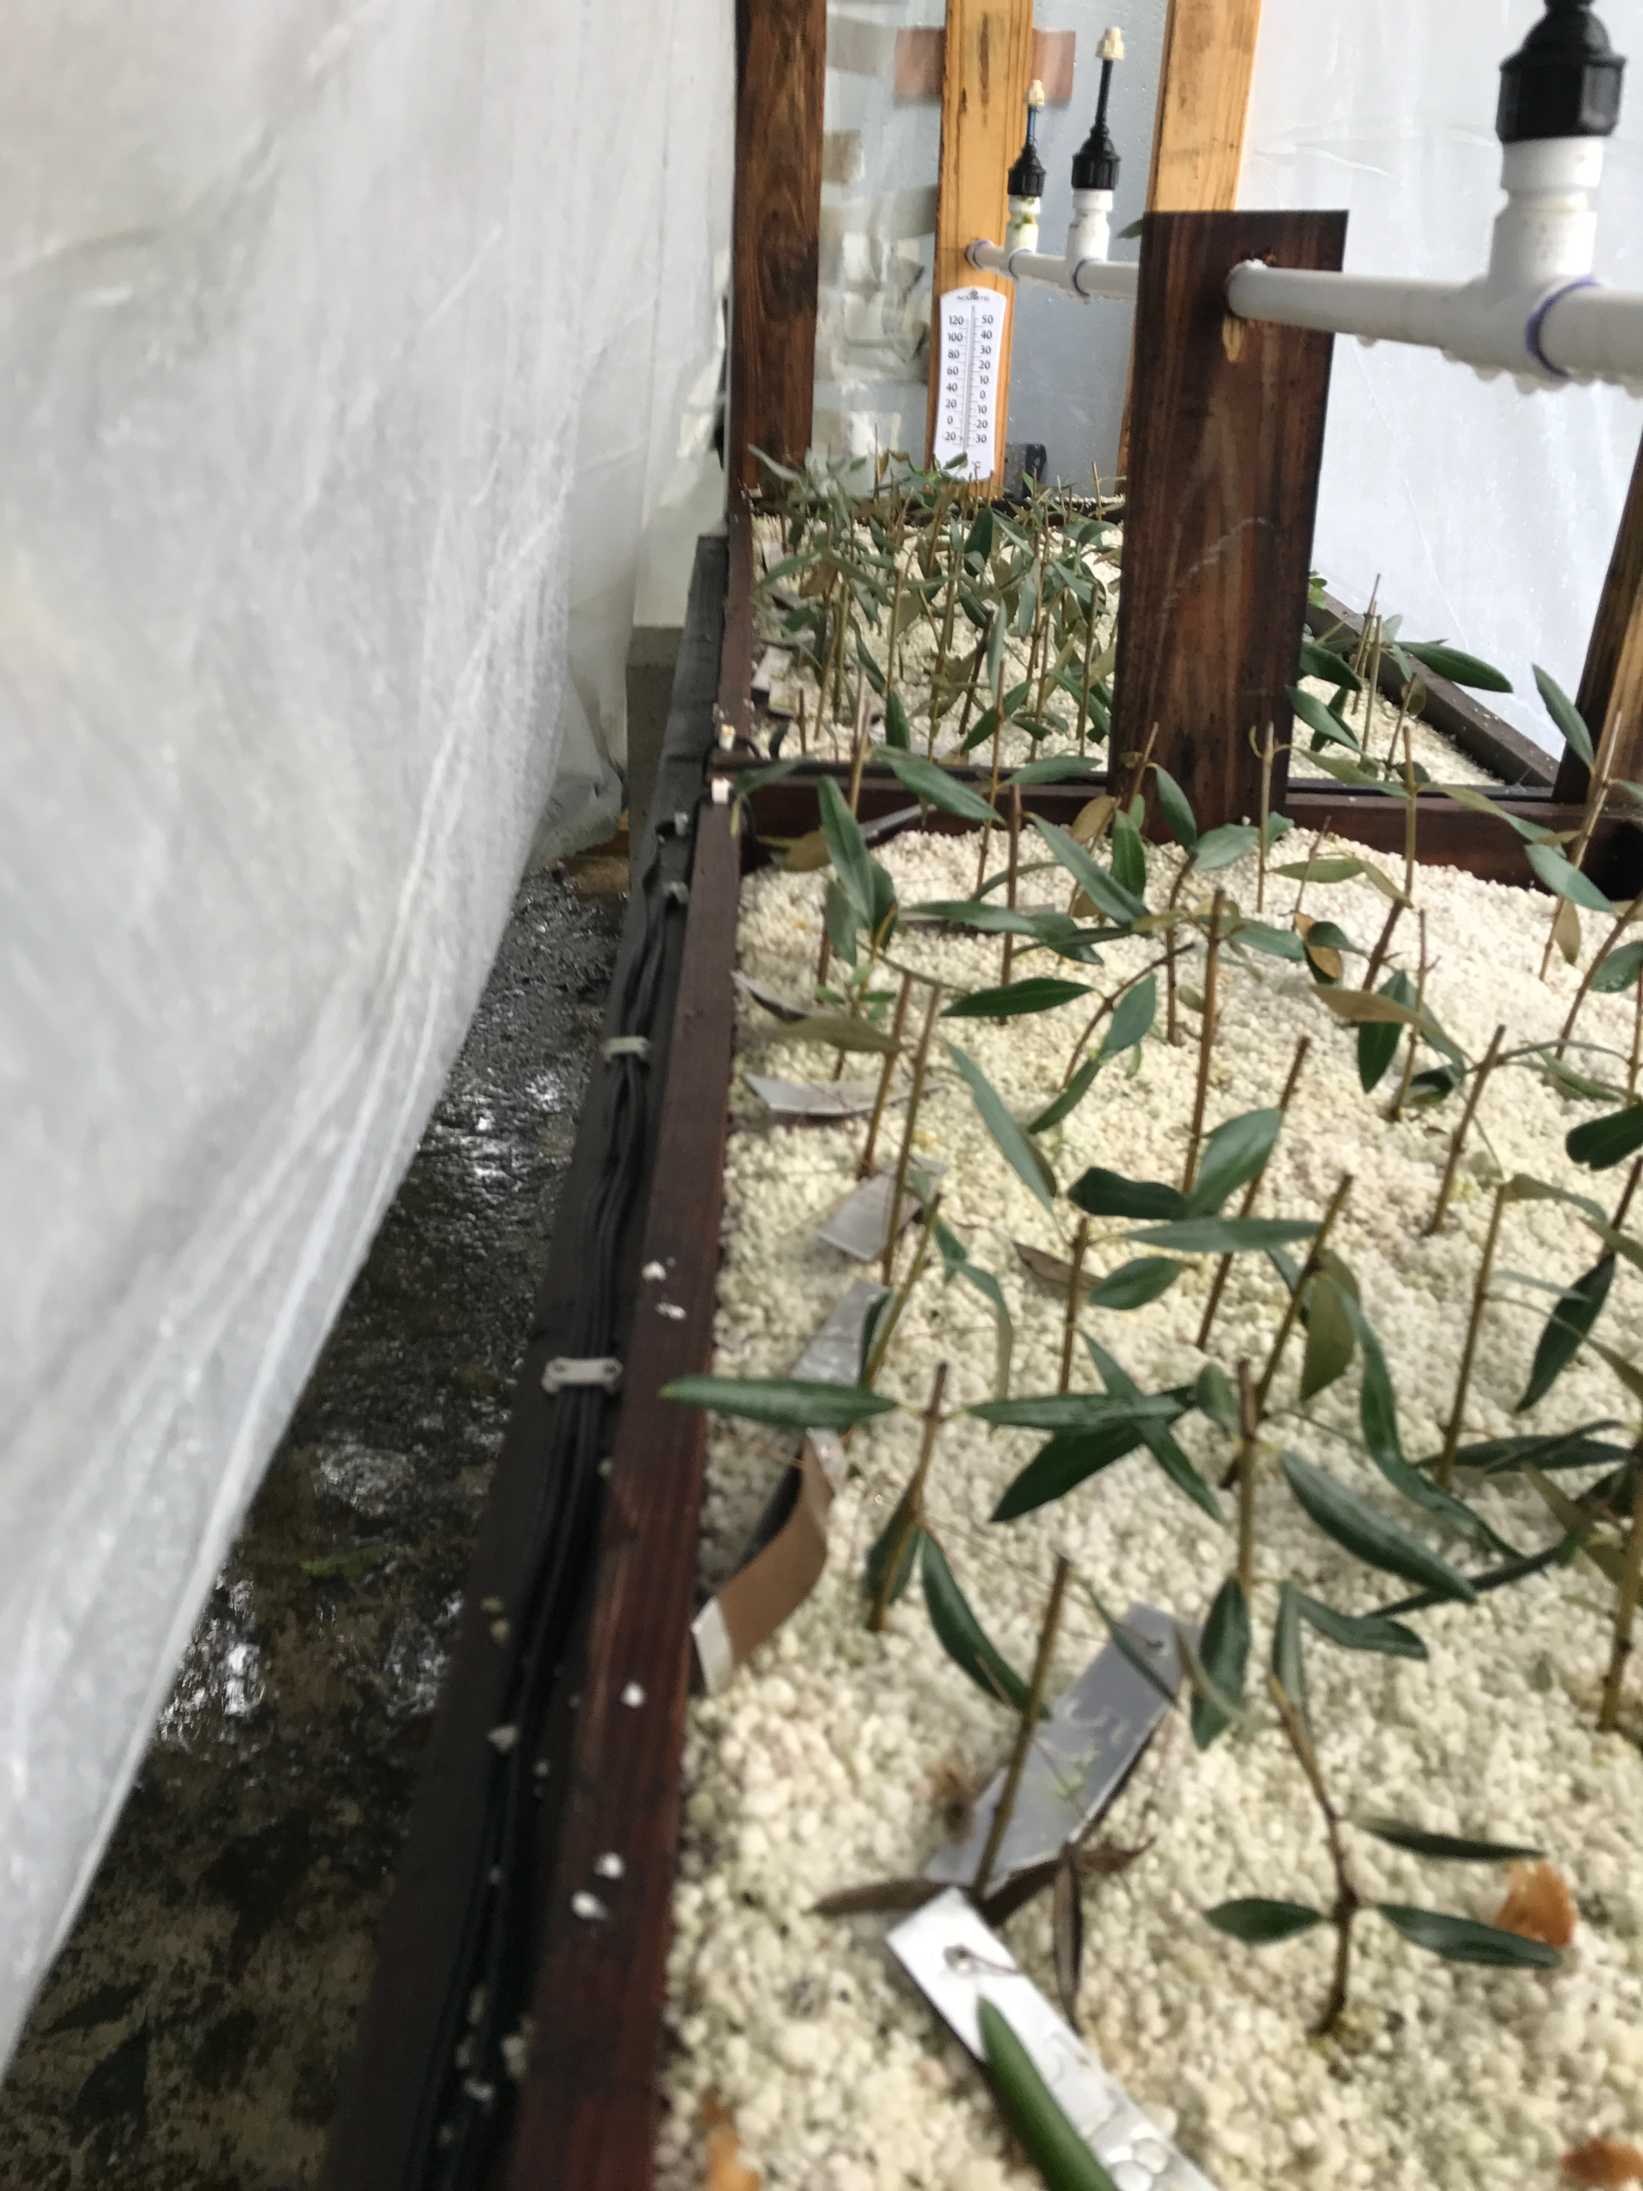
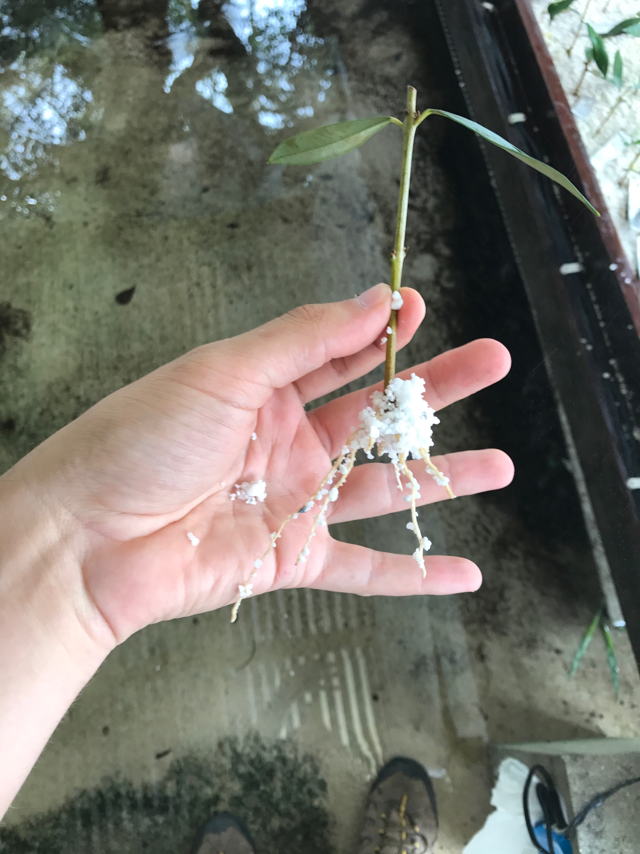
Rooting Program
24 North African Varieties

Slide 15
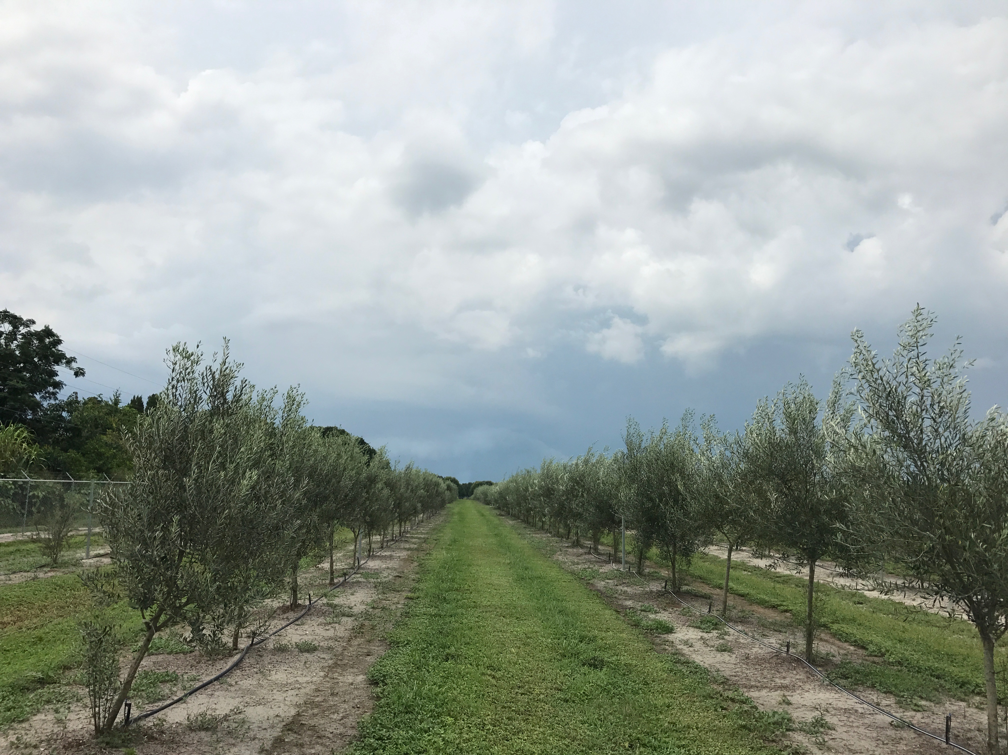
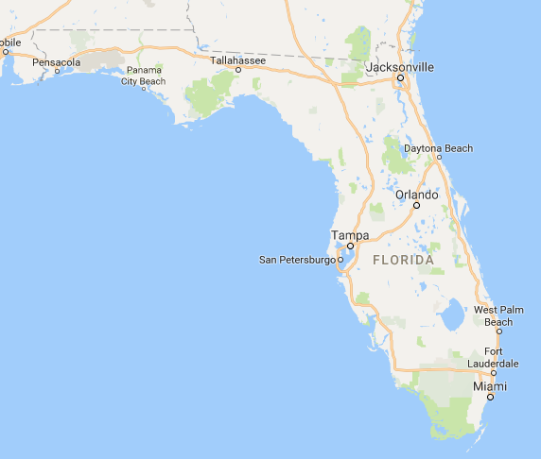
Grafting program
Wauchula, Hardee County Facility.

Slide 16
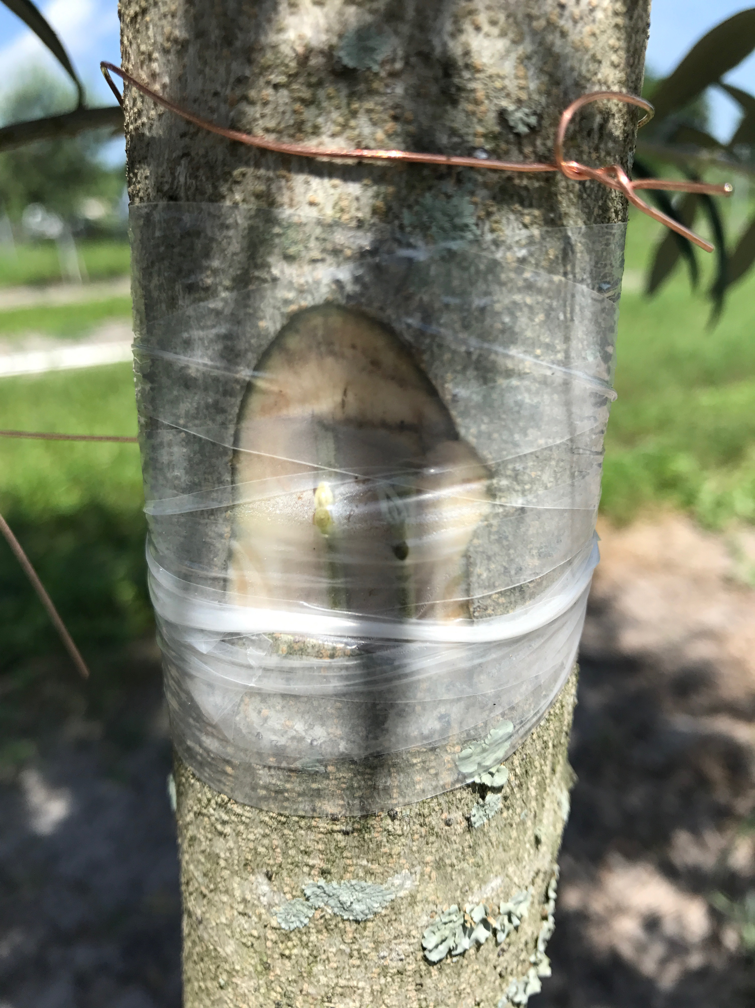

Slide 17
Questions?
© 2016 Florida Olive Council, LAA. All Rights Reserved

