Slide 1
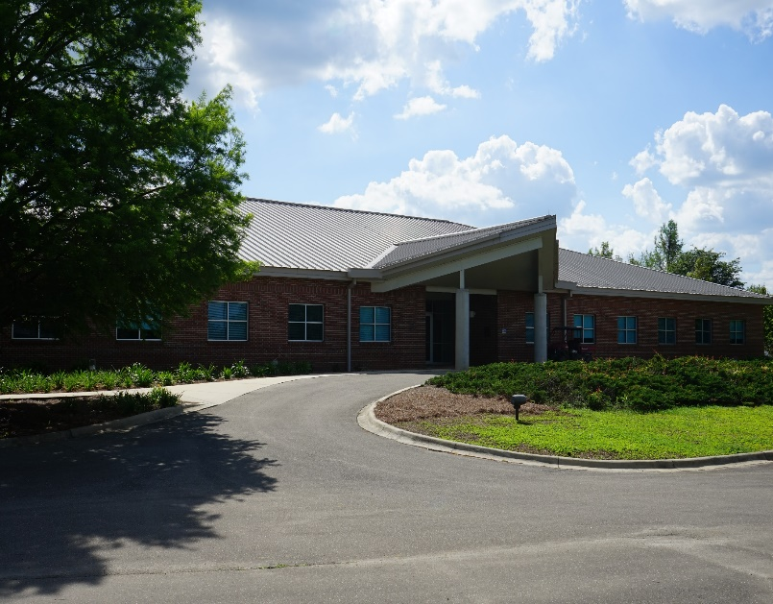
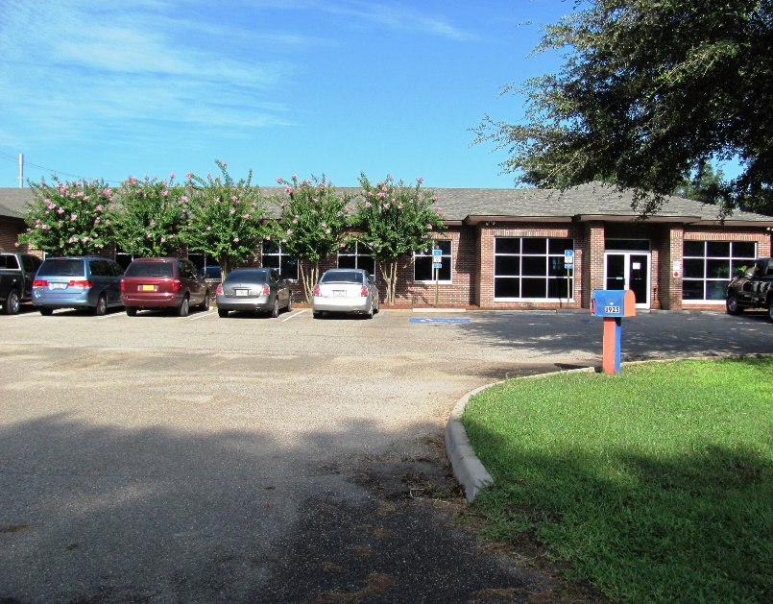
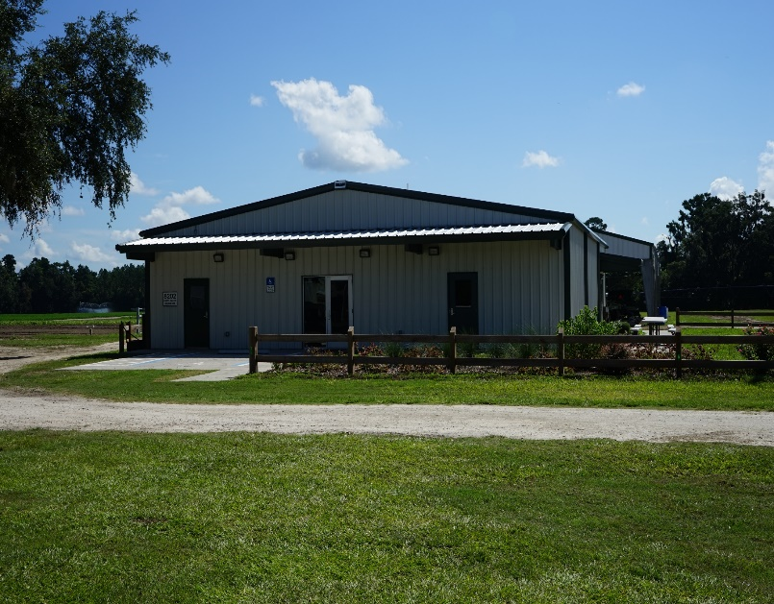
North Florida Research and Education Center
Quincy, Marianna and Suwannee Valley

Slide 2
Topics
• Hurricane recover
• Events
• New projects

Slide 3
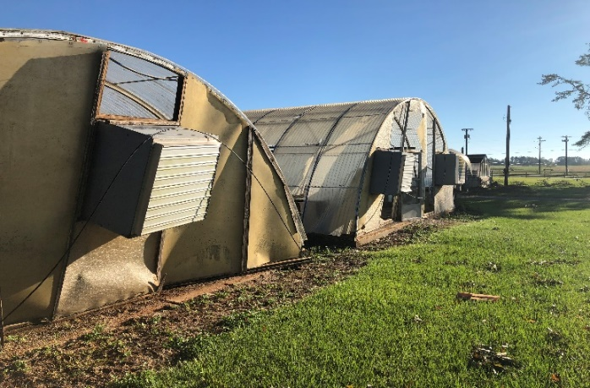
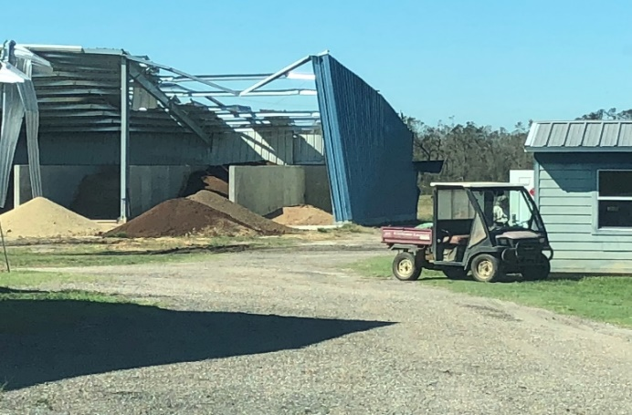
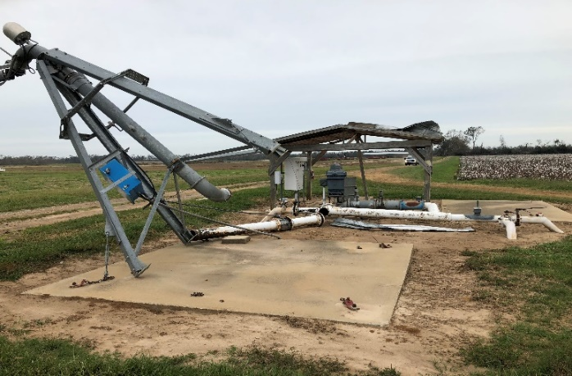
Quincy
Marianna
Recovery from
Hurricane Michael
Marianna

Slide 4
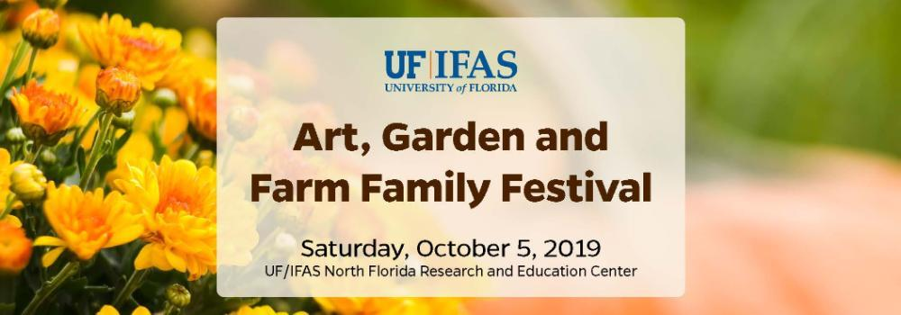
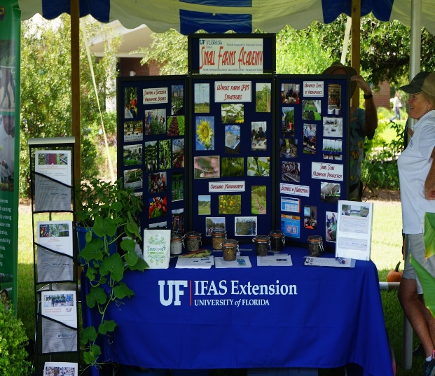
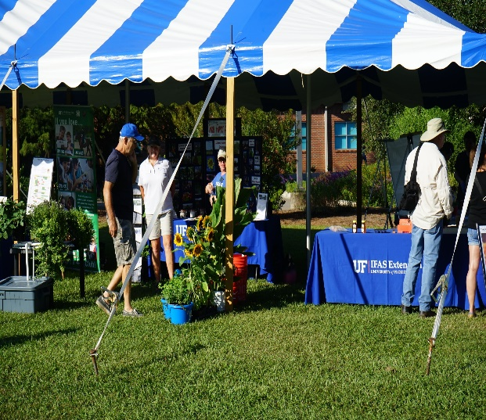
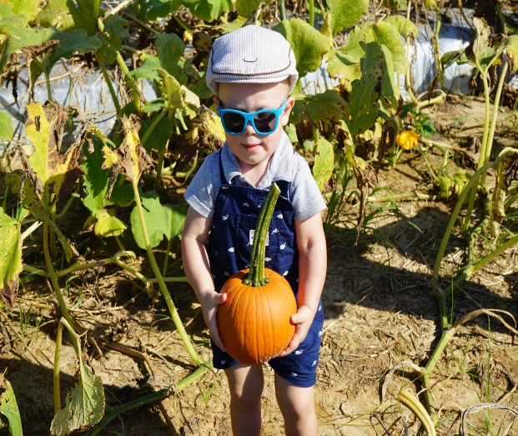

Slide 5
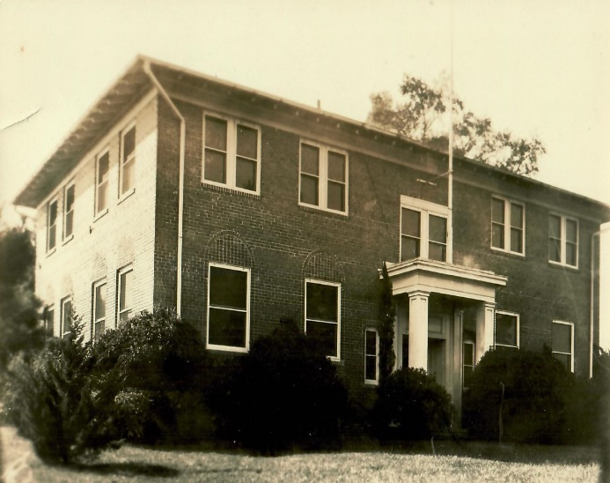
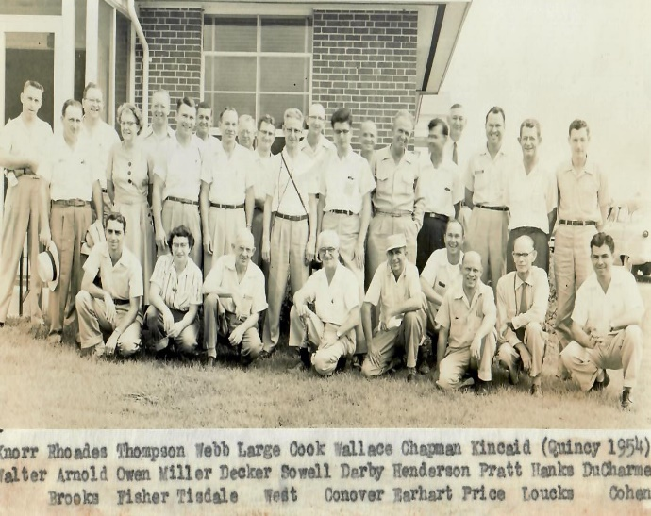
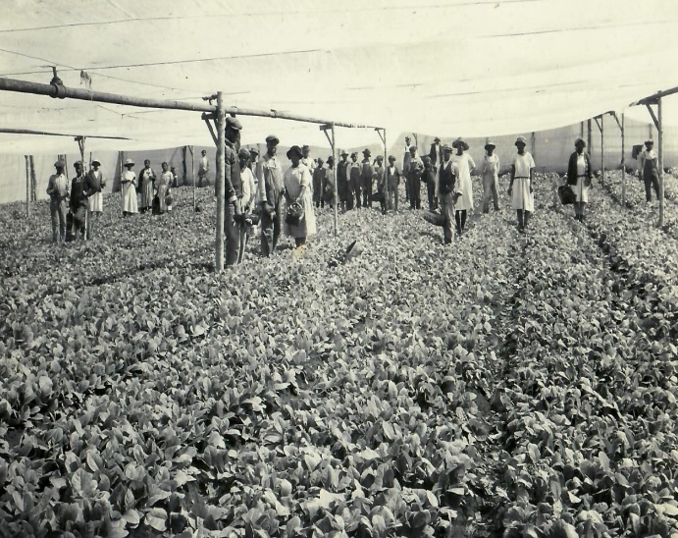
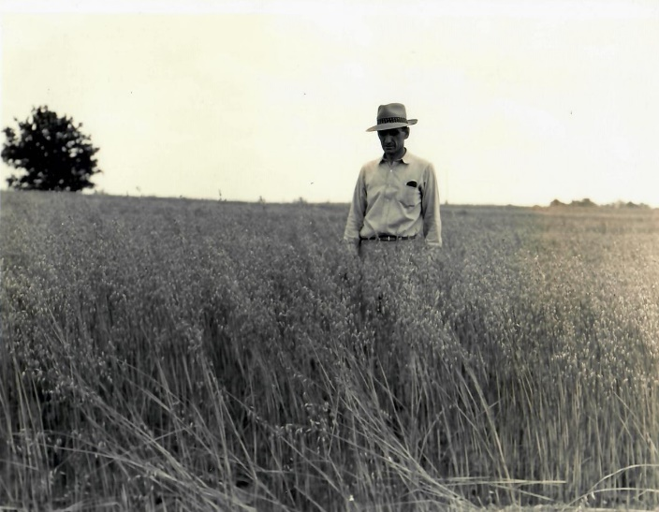
NFREC will celebrate
it’s 100-year anniversary
in 2022

Slide 6
New Projects
More emphasis on
alternative crops
• Alternatives in implementing crop rotations
• Alternatives needed for timber industry as they recover
from hurricane
• Increase diversification of agriculture in Florida
• Alternatives in moving away from traditional commodities

Slide 7
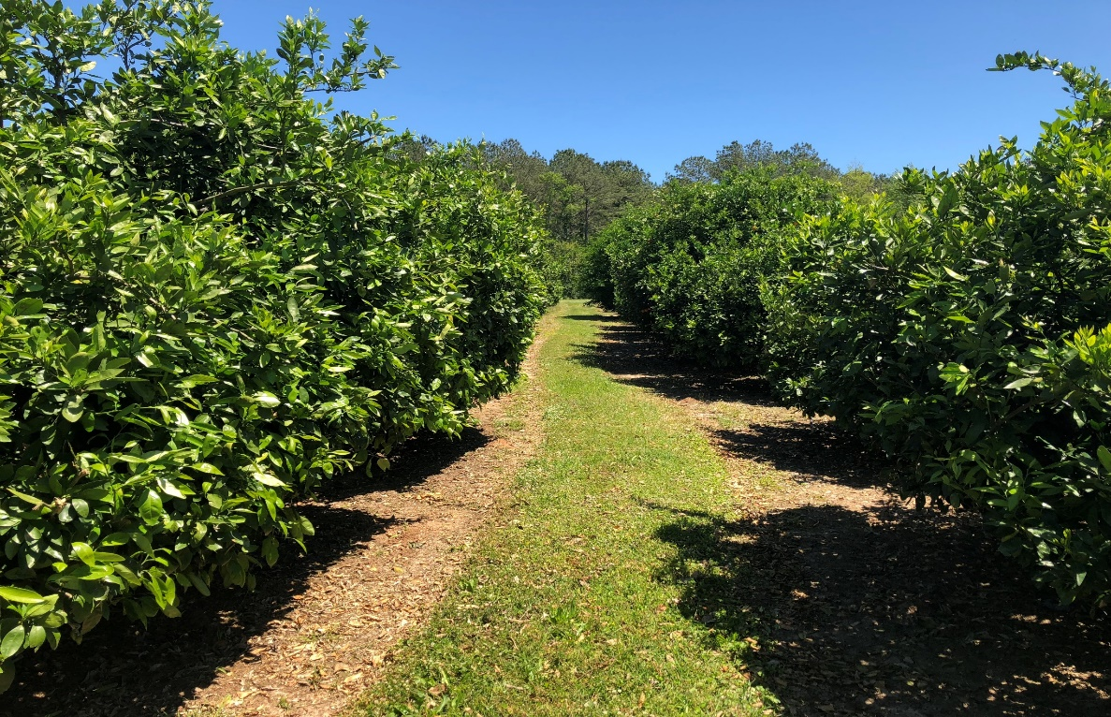
Response to a growing citrus industry
• Replacement of Dr. Pete Anderson,
our fruit and nut tree horticulturalist
• Plans to initiate a citrus project at
Quincy, Suwannee Valley and Jay

Slide 8
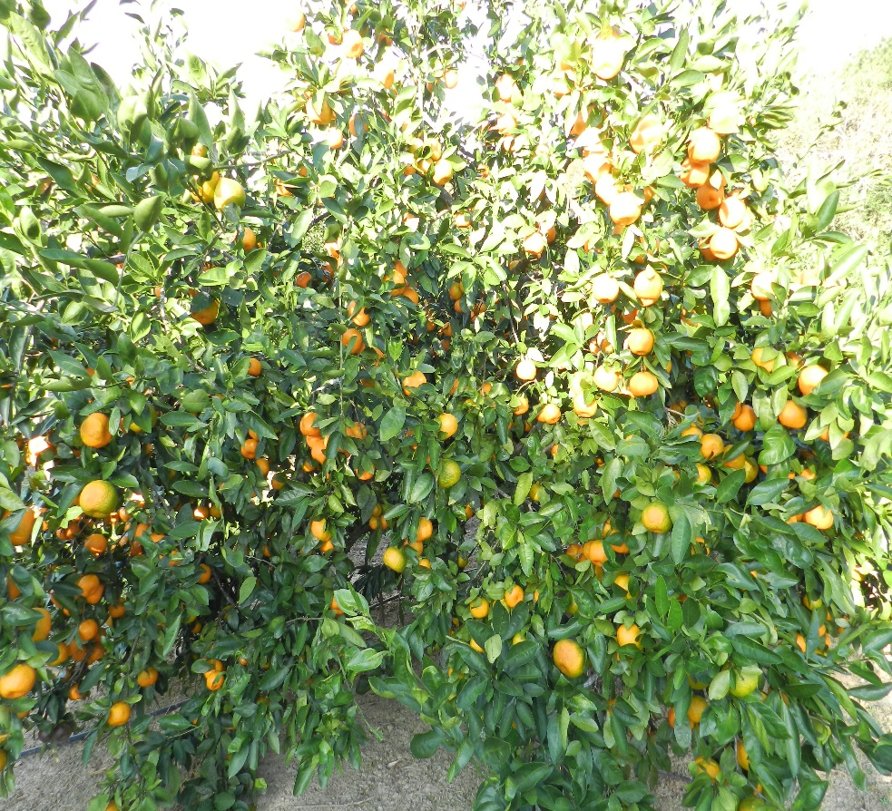
We appreciate our partnership with
Cold Hardy Citrus Association

Slide 9
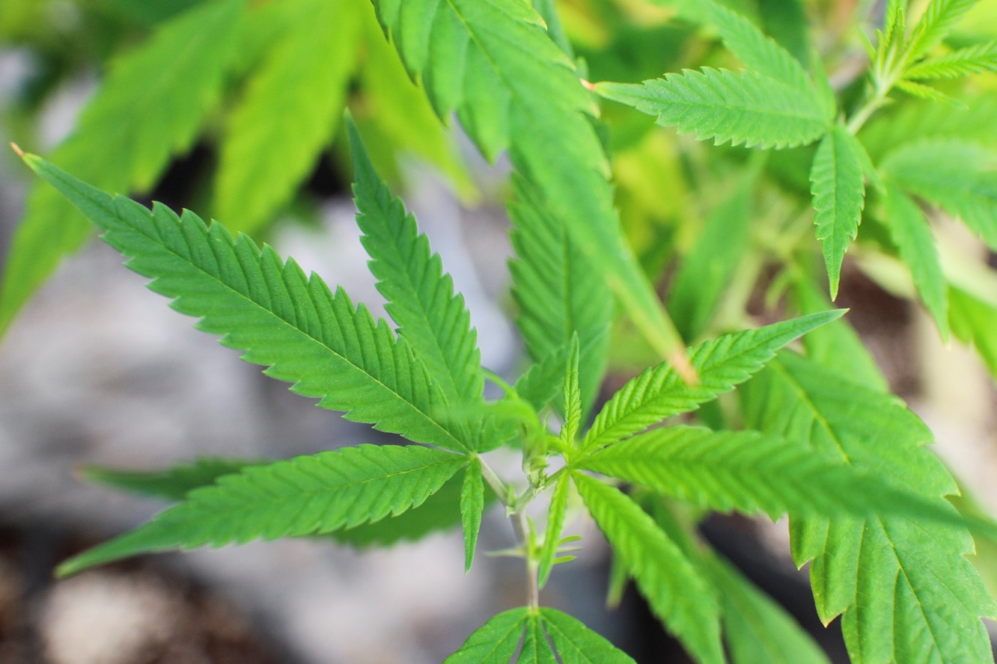
Industrial Hemp
A lot of pressure on IFAS to develop
cultural and management practices

Slide 10
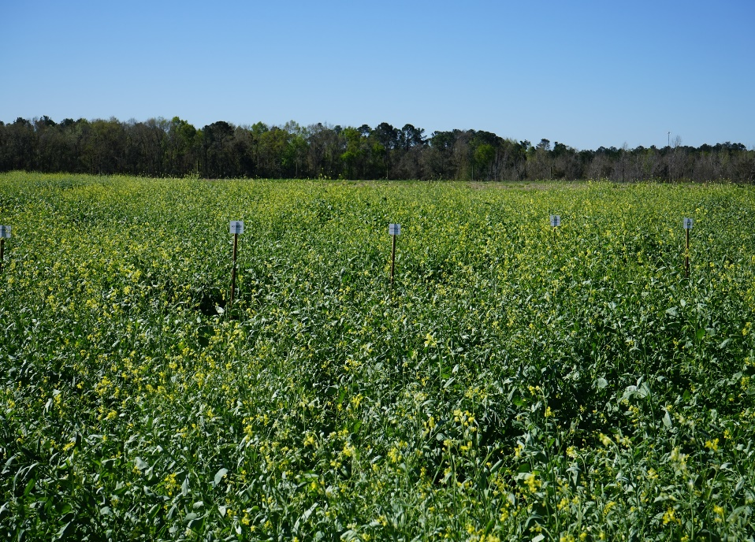
Carinata Program
Dr. David Wright
Cool-season crop producing oil seed
that can be converted to aviation fuel

Slide 11
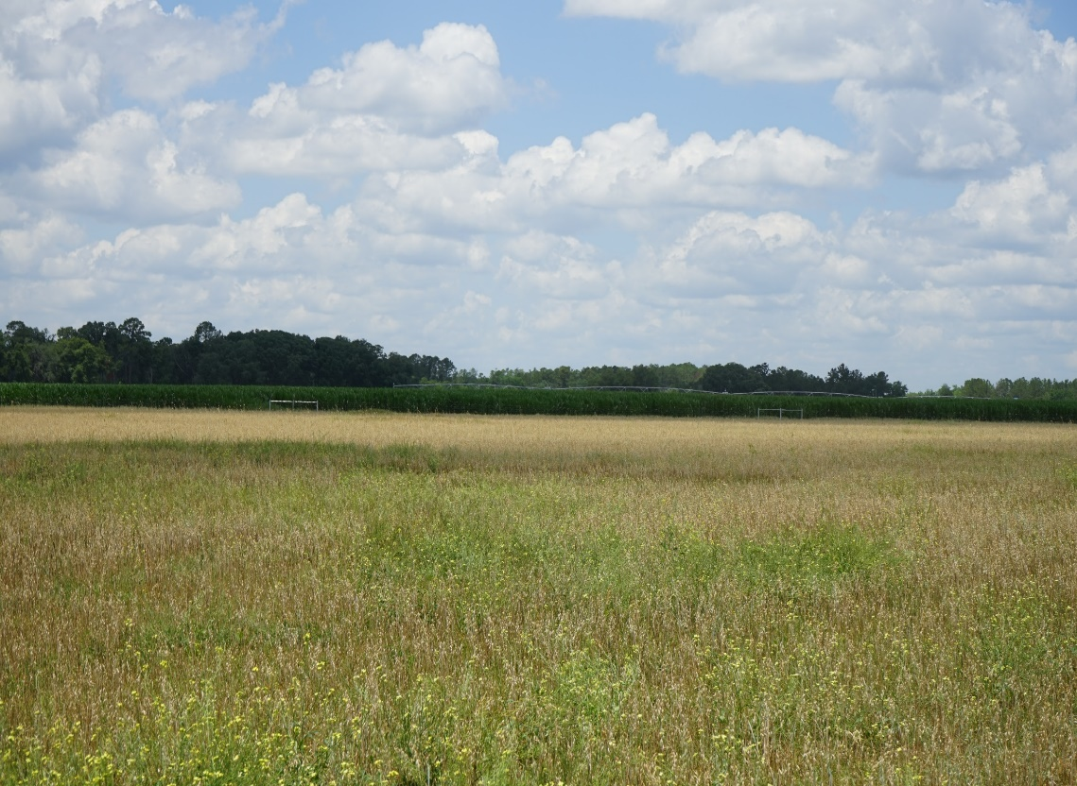
Sod-Based Rotation Demonstration
at Suwannee Valley
Joel Love and Charles Barrett

Slide 12
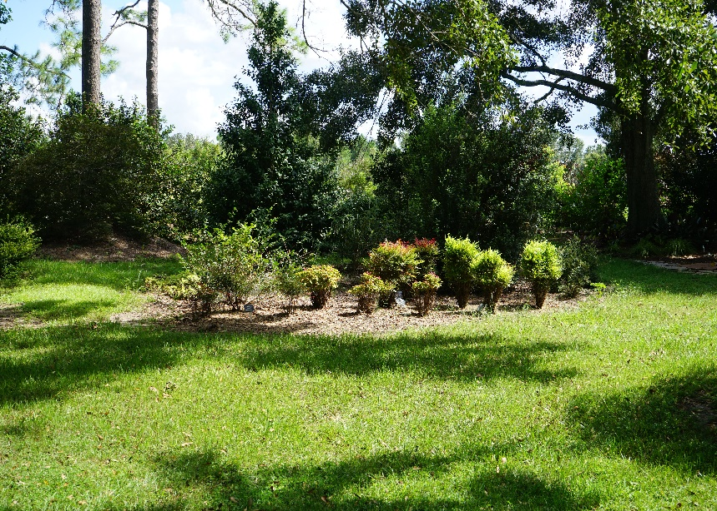
Environmental Horticulture
Dr. Gary Knox
We continue to have a strong partnership with
Garden Friends of the Big Bend
Plans to construct a Heritage Garden
with endowed funds.

Slide 13
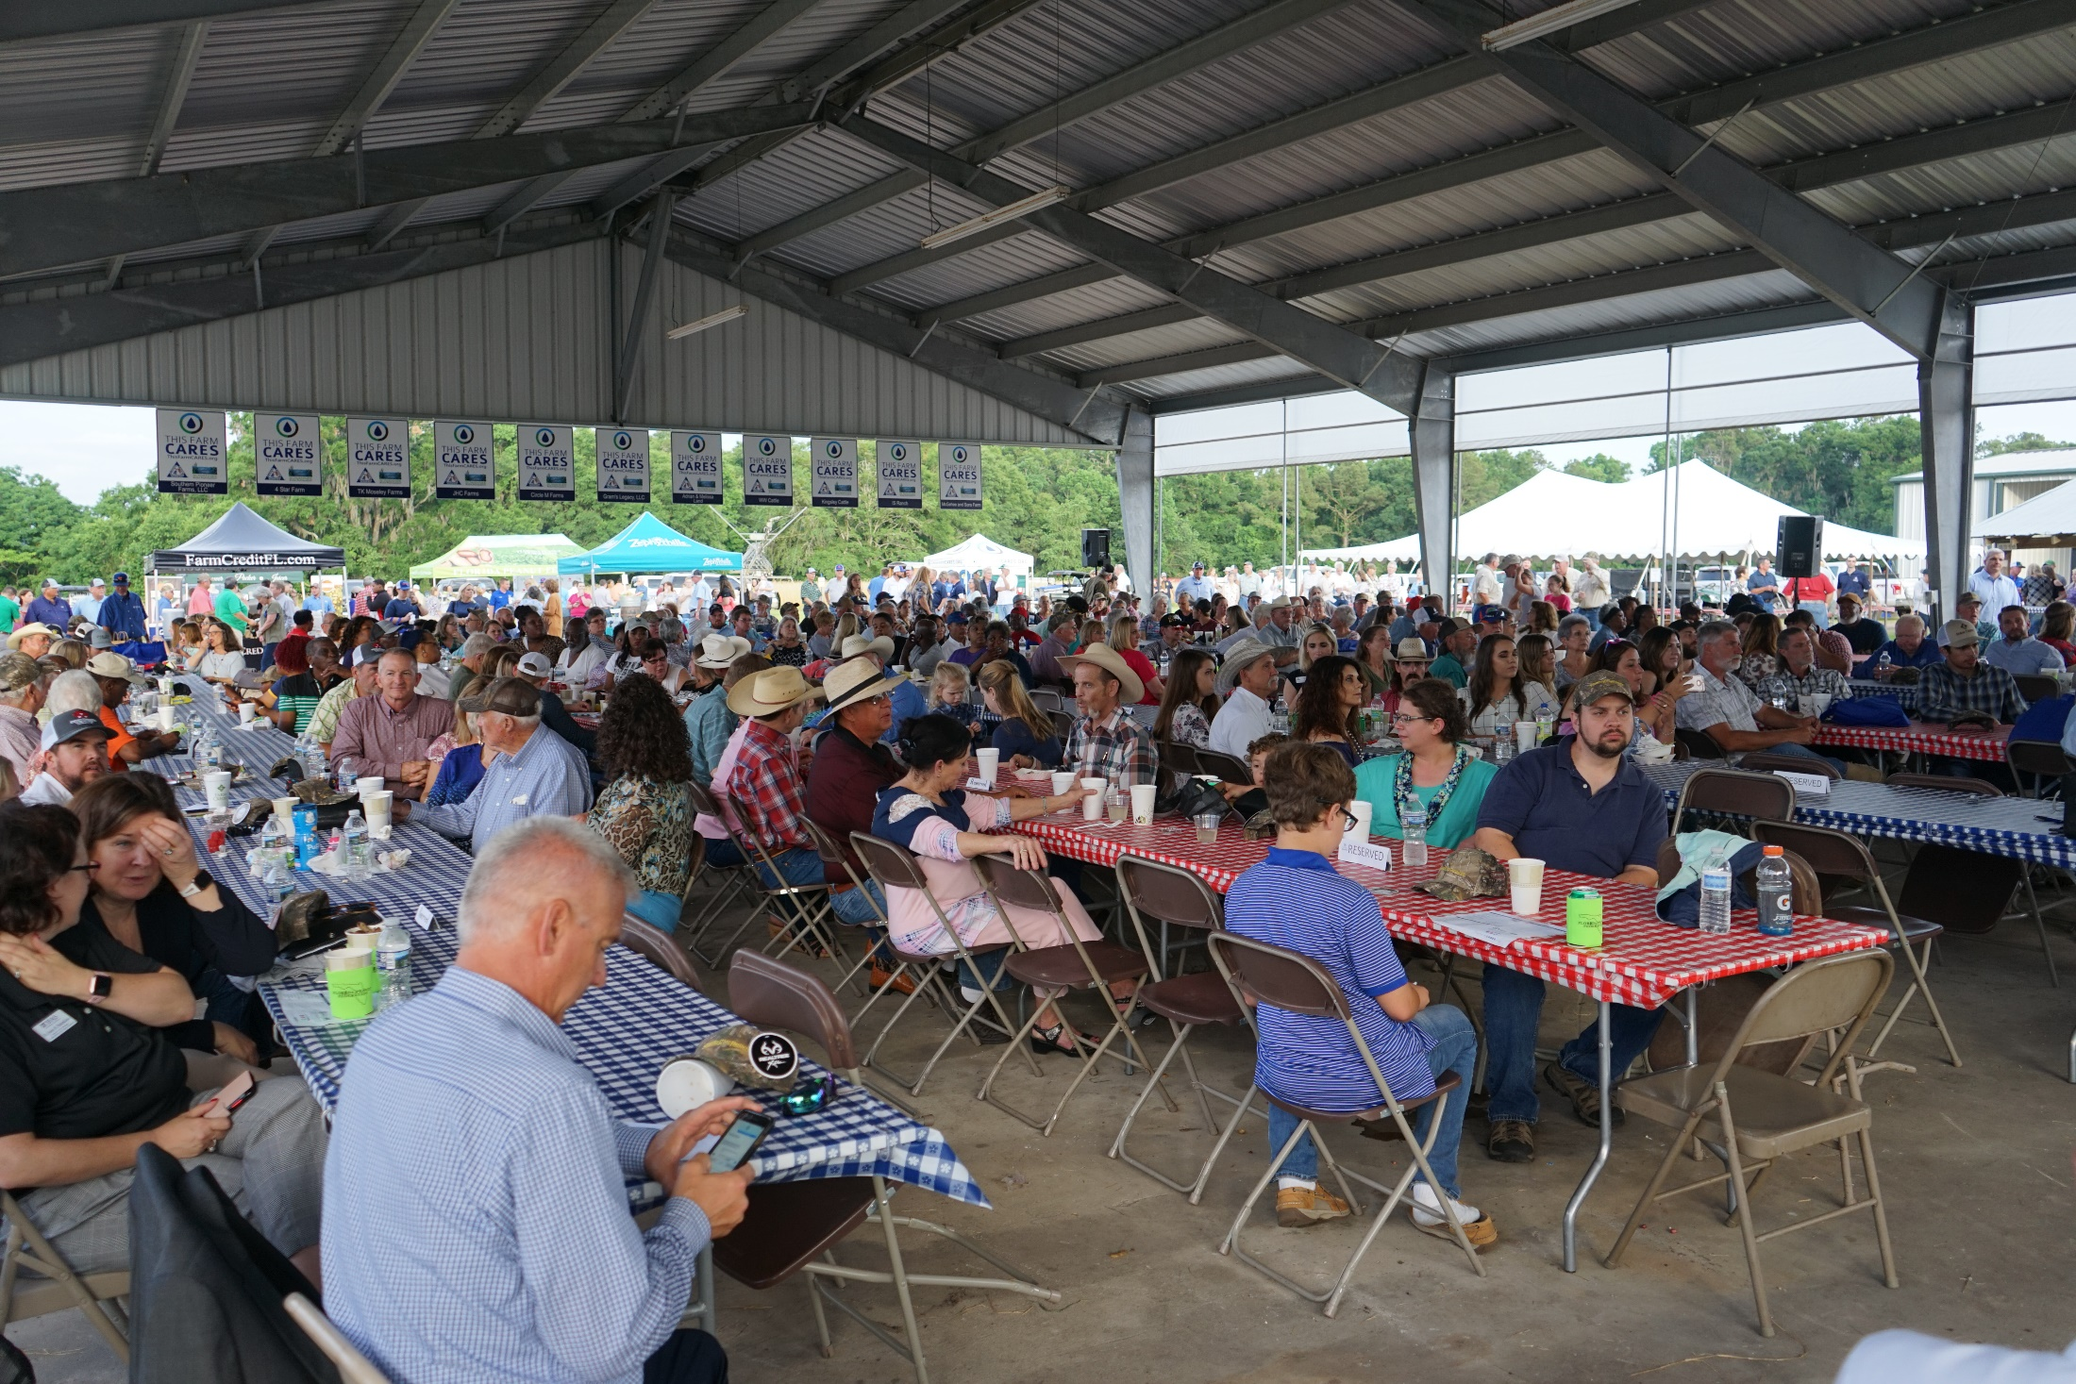
Questions?

